Slide 1

FOUNDATION PSYCHIATRY in SPFT KSS WELCOME EVENT
Dr Stavros Bekas MD MSc MA FHEA
Foundation Programme Lead Tutor
Lead Psychiatrist, Community Adult Services East Sussex

Slide 2
The Aims of the Foundation Programme
The UK Foundation Programme is designed to support the transition from medical student to a doctor that is:
1. an accountable, capable and compassionate clinician;
2. a valuable member of healthcare workforce and;
3. a professional, responsible for their own practice and portfolio development.
These form the three Higher Level Outcomes (HLOs) of the Foundation Programme.

Slide 3
Sussex partnership NHS Trust
All ‘psychiatry’ placements in the Sussex KSS area are offered here
Child and adolescent mental health services (CAMHS)
Community based services
Inpatient services
Specialist older adults and dementia services
Specialist services
Urgent care services
Hospitals Units

Slide 4
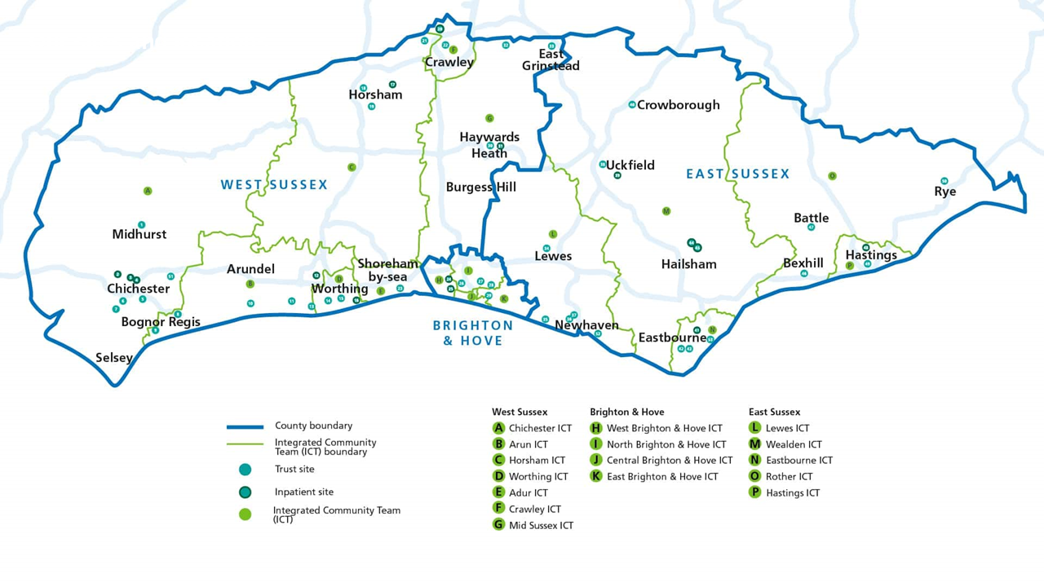
Our geography

Slide 5
Why Psychiatry?
Mental Illness prevalence
Integration and Community emphasis
Generic, transferable skills
Careers and Recruitment

Slide 6
Good medical practice and the foundation doctor
Covers a lot of the Curriculum based on the General Medical Council’s (GMC) documents
• build on undergraduate education by instilling recently graduated doctors with the
attributes of professionalism and the primacy of patient welfare, with both acute and long-term conditions
• provide generic training that ensures foundation doctors develop and demonstrate
a range of essential interpersonal and clinical skills for managing patients with both
acute and long-term conditions, regardless of the specialty
• provide a variety of workplace experience during your
foundation programme in order to best inform career choice.

Slide 7
The ‘parity of mental health’ and the importance of social wellbeing
emphasises the importance of mental and social wellbeing on physical health and list explicitly the areas of mental health which FDs should acquire competence
– Depression
– Mania
– Psychosis
– Anxiety/panic
– Personality disorder
– Delirium, dementia
– Eating disorders
– Addictions
– Somatisation disorders, including functional syndromes

Slide 8
• assessing capacity and using Mental Capacity Act;
• Mental Health Act 1983
• relevant ethical framework around difficult decision-making,
• understanding that physical disease can present with psychiatric symptoms
• serious adverse effects of common psychotropic medications
• communicating with and managing a disturbed or challenging patient
risks manage mental health patients to themselves and to others;
• explaining a diagnosis to a patient (or carer) who has Medically Unexplained Symptoms (MUS) or a non-organic cause for their symptoms, e.g. panic disorder presenting as chest pain.

Slide 9
The RCPsych anticipates you to be able to:
• Elicit a basic clinical history for a common psychiatric disorder
• Perform a mental state examination for a common psychiatric disorder
• Perform a cognitive screening assessment
• Perform a risk assessment
• Make a concise case presentation and initial management plan for a common
• Psychiatric disorder
• Write an accurate and concise report, assessment or referral

Slide 10
Extras
Shadowing other services within psychiatry
Oncalls for some of you
If you want to do a locum in your free time, get in touch
Tasters that come out of study leave usually are approved
F1 Posts will allow acute ‘in-touch’ sessions along with regular Foundation teaching to develop the generic clinical competencies and do procedures
Different ways of achieving this by each Acute Trust
E.g F1 to Join the a acute floor clerking team, A&E or weekend oncalls;
All F trainees have 2 hours ‘personal development’ time per weekly schedule

Slide 11
CONTACT
S.Bekas@nhs.net

