Slide 1



Maidstone and Tunbridge Wells
NHS Trust
KSS Foundation School
Welcome Event 2026
Tuesday 17th March

Slide 2
Meet the Team
Dr Bet Mishra Deputy Director of Medical Education &
FY1 Training Programme Director (Maidstone)
Dr Emma Townsend Postgraduate Medical Education Lead for TWH & FY1 Training Programme Director (Tunbridge Wells)
Dr Amit Saha FY2 Training Programme Director (Maidstone)
Miss Sarah Flint FY2 Training Programme Director (Tunbridge Wells)
Medical Education
Julie Knowles, Foundation Manager
Anita Mann, Medical Education Manager
Joanna Woollard, Deputy Undergraduate Manager
Trainee Representative
Dr Praharsh Babu, FY2 Foundation Doctor

Slide 3
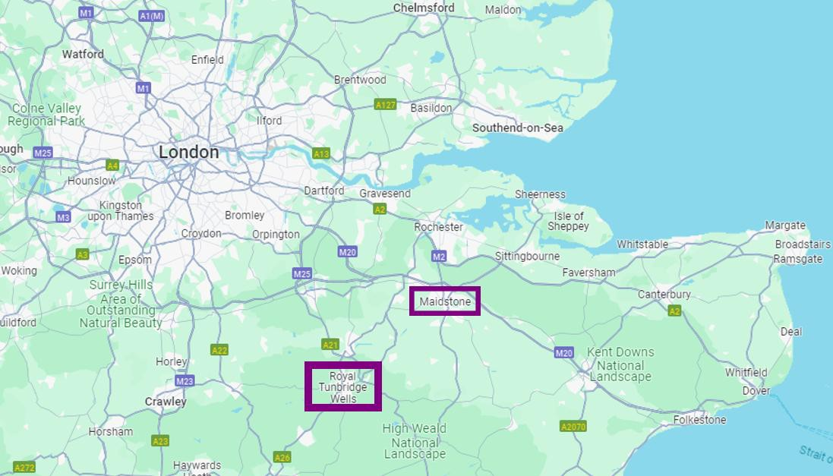
Location
Maidstone and Tunbridge Wells
A 25 minute drive between each hospital site OR a 30 minute free staff shuttle bus.
Located approximately a 1 hour train journey from London.

Slide 4
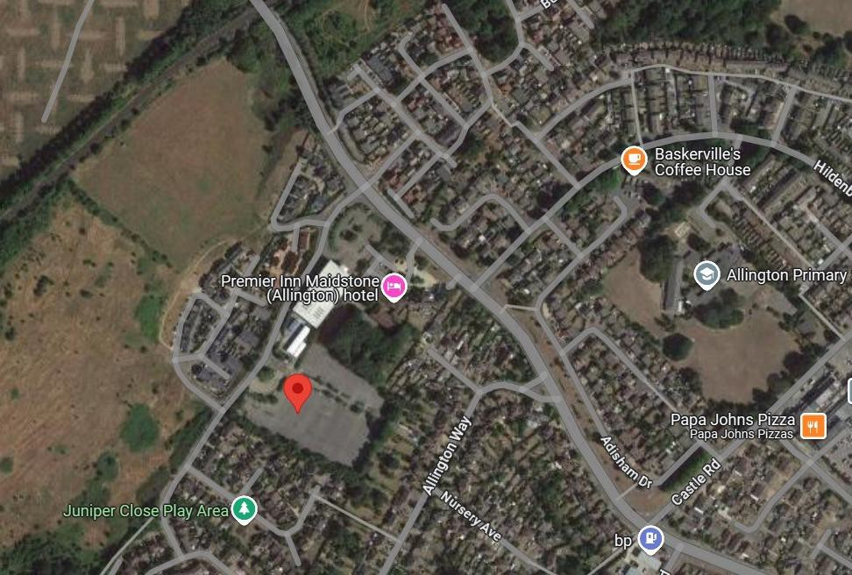
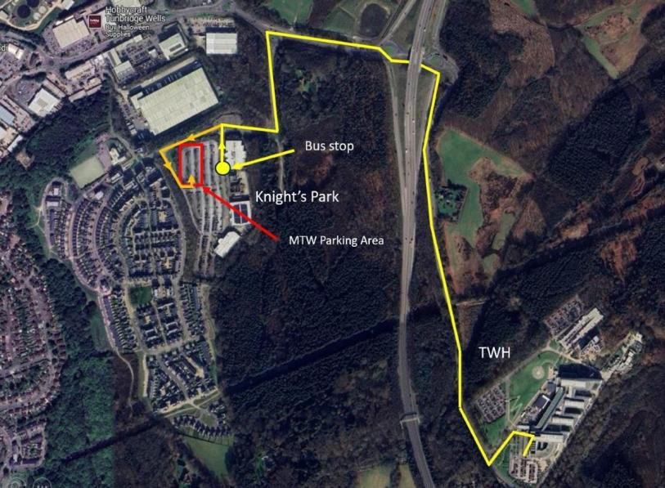
Car Parking
A monthly permit costs £24 or you can ‘pay as you go’ for £2 a day.
There is also a park and ride service available for each hospital which is free to use and takes 10 minutes or less to get on site.
Maidstone — London Road
(ME16 0LP)
Tunbridge Wells — Knights Park
(TN2 3UW)

Slide 5
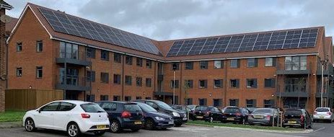
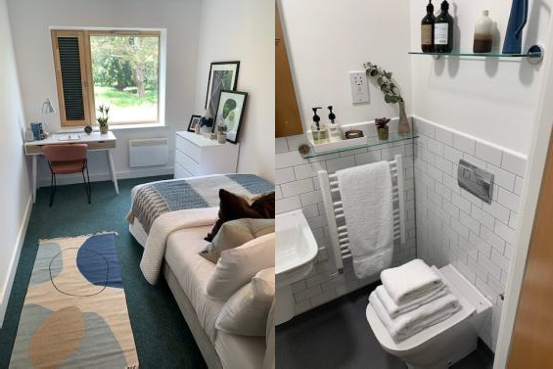
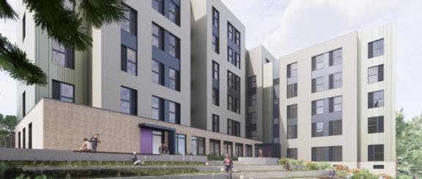
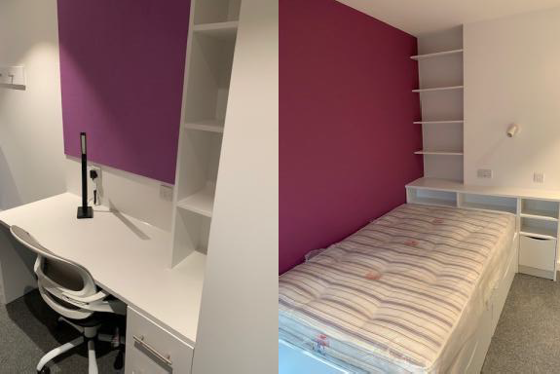
Accommodation
Maidstone Accommodation
The Springwood Road accommodation is a 10 minute walk from Maidstone Hospital.
The accommodation comprises flats of 5,6 or 7 all en-suite with their own shared kitchen, eating and lounge area.
Each room is equipped with a bed, desk, chest of drawers, bedside cabinet and wardrobe. The lounge areas have a dining table, chairs, sofa and a flat screen TV.
Facilities include: WiFi, Card access to building, flats and rooms, laundry room, domestic services for all communal areas, car parking and lockable bike storage.
Tunbridge Wells Accommodation
The new accommodation and educational facilities on the Tunbridge Wells Hospital site comprises of 145 rooms, a leisure room and educational facilities.
The accommodation comprises of flats of 4 or 6 rooms all en-suite with their own shared kitchen, eating and lounge area.
Each room will be equipped with a bed, desk, chest of drawers, bedside cabinet and
wardrobe.
The lounge areas have a dining table, chairs, sofa and a flat screen TV.
Facilities include: Wifi, Card access to building, flats and rooms, laundry room, domestic services for all communal areas, car parking and lockable bike storage.

Slide 6
Placements
Here are a selection of the placements available at our Trust
during your Foundation Programme:
Acute Medicine Anaesthetics Cardiology
Diabetes & Endocrinology Emergency Medicine Geriatric Medicine General Practice Genitourinary Medicine Haematology
Obstetrics & Gynaecology
Ortho-geriatrics
Otolaryngology (ENT)
Paediatrics
Palliative Medicine (Hospice)
Pathology
Psychiatry
Public Health
Respiratory Medicine Stroke Medicine
Trauma & Orthopaedics Urology
Specialist Foundation Programmes (SFP) – in either Digestive Diseases (Gastroenterology) Cardiovascular, Respiratory Medicine working on and developing research projects

Slide 7
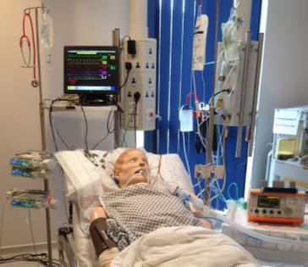
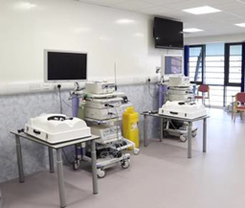
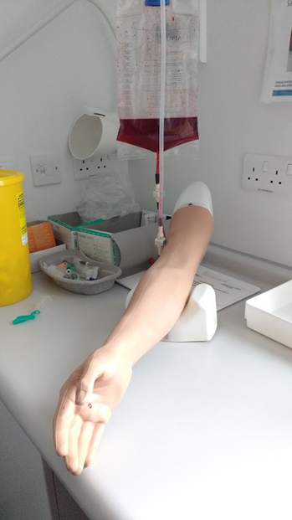
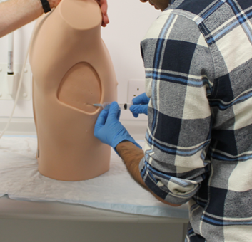

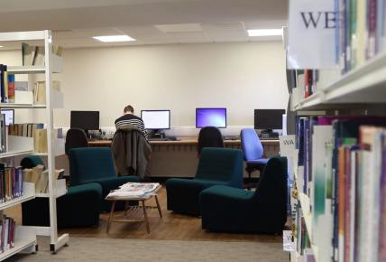
Education centres
Both hospitals have Education Centres with Simulation suites and clinical skills rooms. As well as high fidelity manikins (adult, paediatric, obstetric) there are a wide range of clinical skills trainers.
These are available for skills practise, and all Foundation doctors receive simulation training and clinical skills training within their foundation teaching programme
24/7 access Libraries are available on both sites.
Modern I.T facilities and Wi-Fi access is available throughout the hospitals.

Slide 8
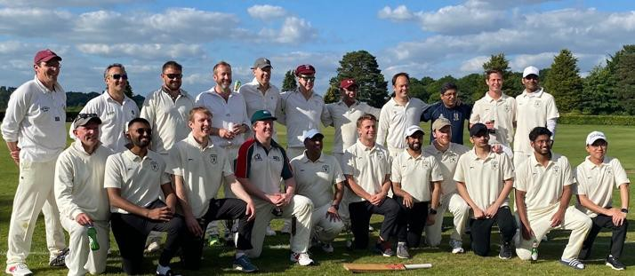
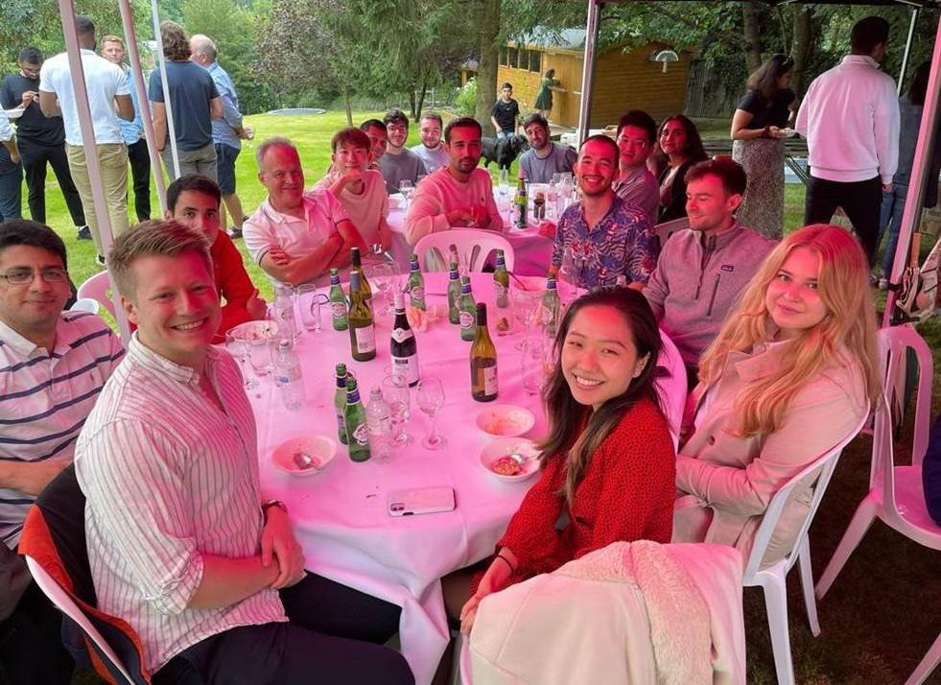
Social Activities/ Doctors Mess
We have an active Doctors’ Mess Committee who arrange various social events throughout the year including ‘pay day’ themed outings and other regular mess nights organised by F1s.
We also hold an annual cricket match
Residents against Consultants.
As a part of the F1 Induction you will be invited to attend our annual F1 BBQ. This will be a good opportunity to get to know your F1 colleagues whilst enjoying delicious food at our scenic venue!

Slide 9
Local Amenities / Attractions
Maidstone
Maidstone has its own shopping complex, many restaurants, bars, gyms, leisure
centres, a cinema and theatre all within easy access from the hospital.
Leeds castle, Mote Park, the Hop Farm and Bluewater Shopping Centre are local attractions open all year round that are easily accessible using local transport links.
Tunbridge Wells
Tunbridge Wells is renowned for its superb range of high street and boutique shops, restaurants, cafes, pubs and bars. Two theatres means access to regular plays, dance and comedy performances. There is easy access to the gym, cinema, bowling and many retail outlets at Knights Park Leisure complex.
The hospital is situated in an area of outstanding natural beauty with plenty of opportunities to walk, boat and bike ride including Bewl Water Lake, the Hop Farm and a number of vineyards, castles, gardens and stately homes.

Slide 10
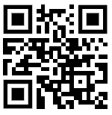
Any Questions?
https://me.mtw.nhs.uk/

Slide 11
We hope that you will consider our Trust for your
Foundation Programme application

