Slide 1
Kent and Medway Mental Health NHS Trust
Placements in Psychiatry
Dr Carolina Pressanto
Medical Education Fellow
Dr Ayesha Ejaz
Foundation Year 1 doctor

Slide 2
My journey so far
Carolina
Medical School/Foundation Years in Brazil
Worked in various roles in Brazil before moving to the UK
First job in the UK as Clinical Fellow for a couple of years
Core Psychiatry Training in Kent
Medical Education Fellow in Kent
Break from clinical practise to go after personal interests

Slide 3
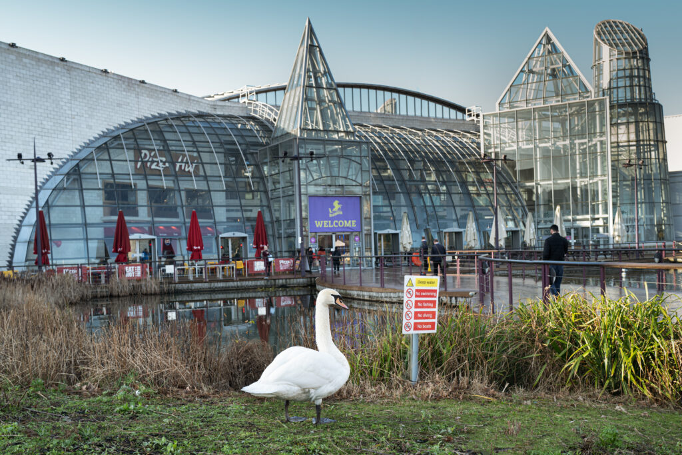

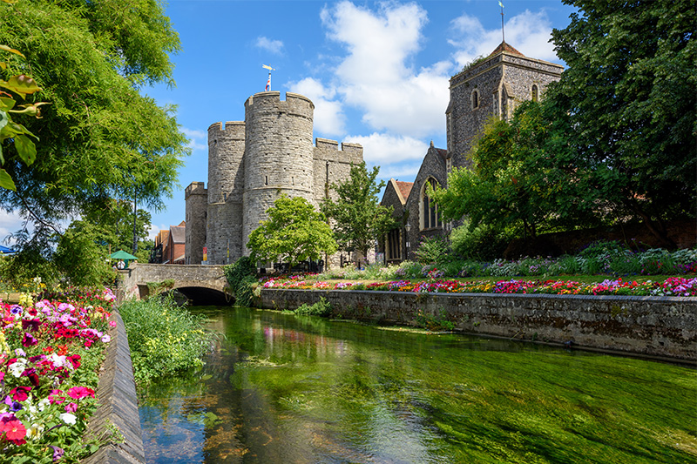
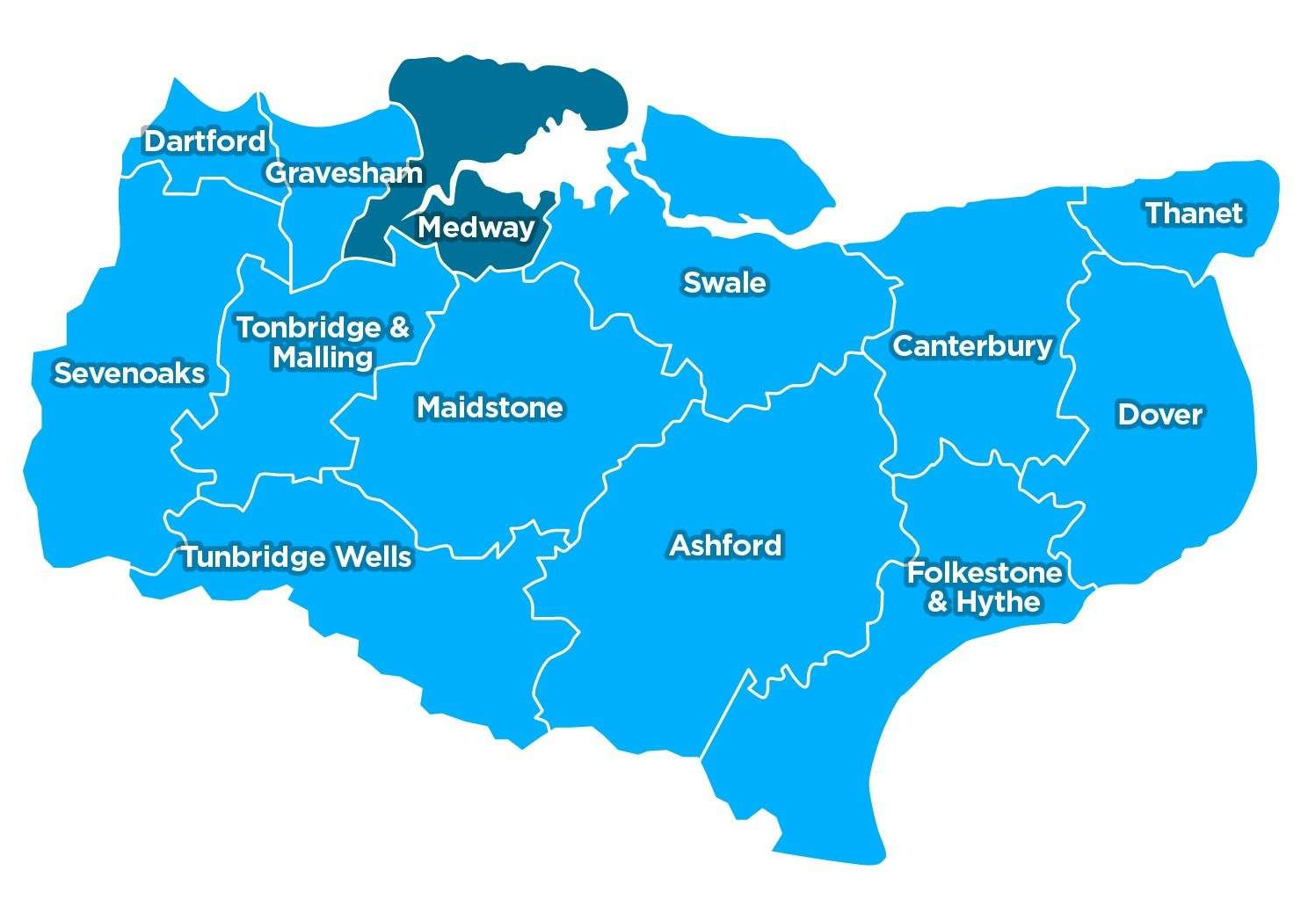
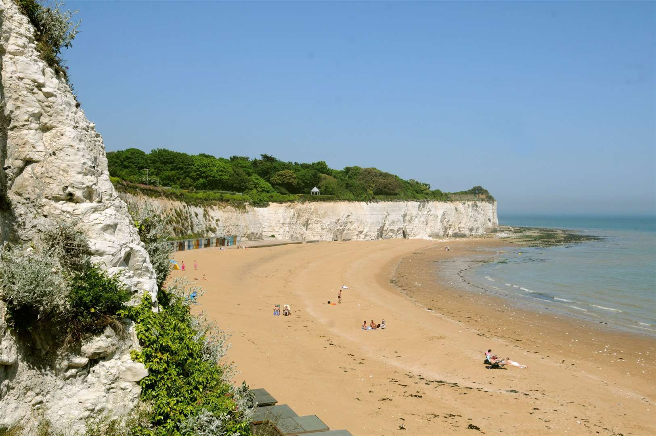
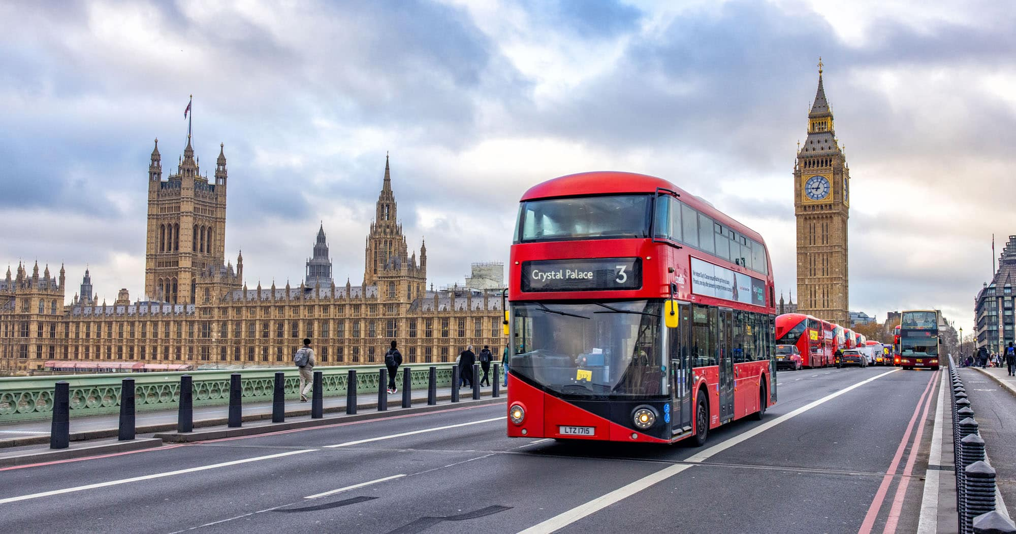
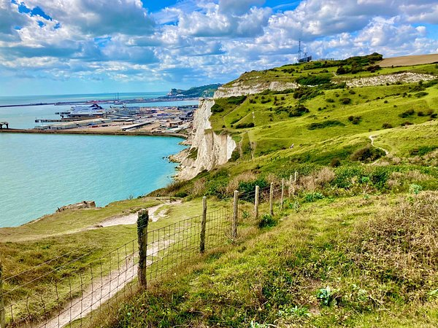
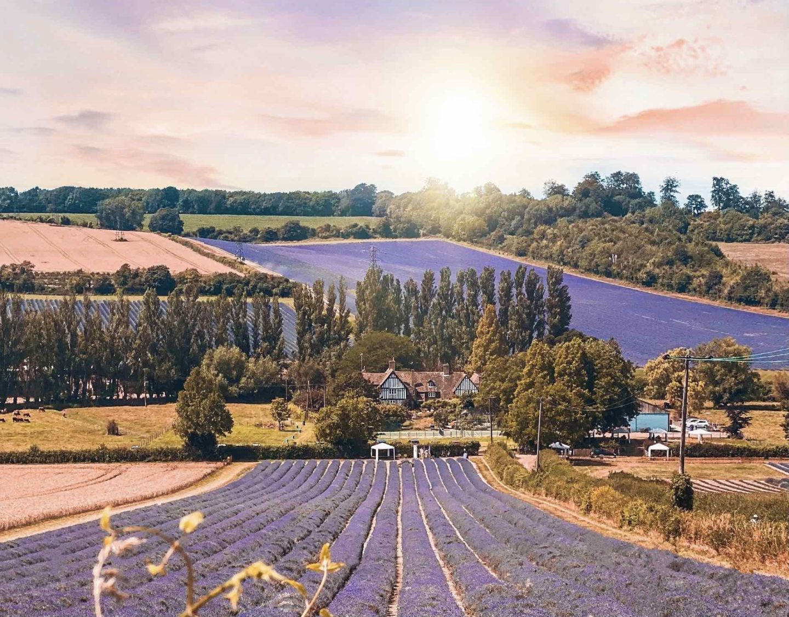
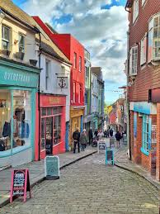

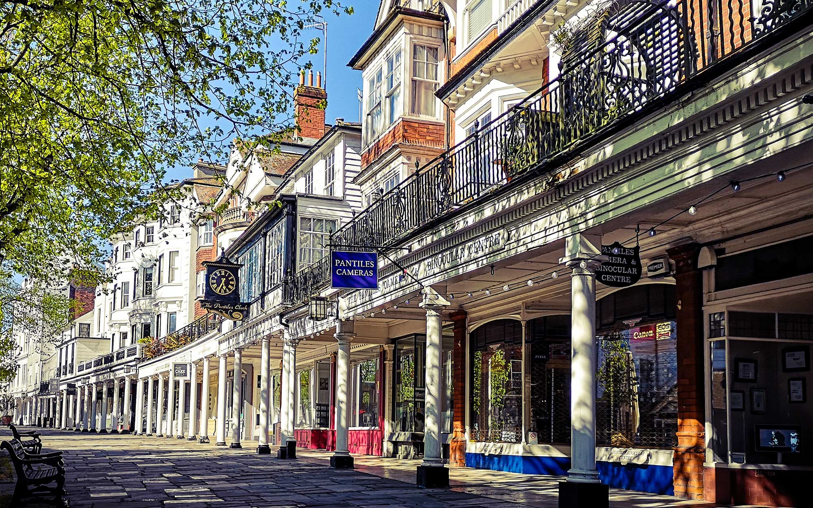

Kent
To London
To France by Ferry
To Surrey
To Sussex
To France by shuttle
Notes:
High-Speed Travel: Kent boasts excellent transport links to London, particularly via the HS1 (High-Speed 1) train line, making London accessible in under an hour from many towns (e.g., Ashford/Folkestone).
Coastal & Rural Lifestyle: 350 miles of coastline.
Easy access to Europe: The shortest distance across the Channel between Kent and France is 21 land miles

Slide 4















Psychiatric Services
General Adult Psychiatry – Inpatient and Community
Old Age Psychiatry – Inpatient and Community
Liaison Psychiatry
Crisis and Home Treatment Team
Perinatal Psychiatry – Inpatient and Community
Addiction Psychiatry
Psychiatric Intensive Care Unit
Forensic Psychiatry – Low and Medium Inpatient, Community
Learning Disabilities
Rehabilitation Psychiatry
Neuropsychiatry
Complex Psychosis Service
Child and Adolescent Services – Inpatient and Community
Eating Disorder Services

Slide 5
Linked Trusts
Dartford and Gravesham NHS Trust
East Kent Hospitals University NHS Foundation Trust
Medway NHS Foundation Trust
Maidstone and Tunbridge Wells NHS Trust

Slide 6
Facilities
Each Hospital site has:
Doctor’s resource room (with computers/AV facilities for virtual meetings)
On call rooms equipped with computer and bed
Library of books relevant to Psychiatry
Chill out room
Free parking
Some sites have multifaith rooms
Access to hot food 24/7 (microwavable food vending machines)

Slide 7
Activities and benefits
Psychiatry with KMMH
Weekly journal club
Weekly Balint group
Weekly Psychiatry Teaching
Bi-annual trainee conference
Local and national audits
Research
Teaching medical students
Welcome lunches
Coffee mornings/
afternoons
E-prescribe
Shadowing

Slide 8
Why do a placement in Psychiatry?
Transferable skills
Strong, bidirectional relationship between physical and mental health - chronic physical conditions increase the risk of mental health issues, and mental health conditions significantly elevate the risk of poor physical health
Communication!!
Learning to manage the agitated/angry patient
Learning about legal frameworks such as Mental Health Act, Mental Capacity Act, DOLS
Learning how to give compassionate, holistic person-centred care to patients who have co-morbid mental illness

Slide 9
Why do a placement in Psychiatry?
Stand out in your portfolio
Time
For reflection, learning and portfolio work
Teaching
Medical students, peers and other health professionals
Leadership
Audits, Quality Improvement Projects
Mentorship and Supervision
Strong Consultant support for career development

Slide 10
My journey so far
Ayesha
ayesha.ejaz2@nhs.net
Medical school in Galway, Ireland
F1: Renal (KCH)
F1: Psychiatry (TMU)
…
Happiness! (Hopefully)
Next rotations: General Surgery, Paediatrics, Gastroenterology, Haematology

Slide 11
The rotation – From an F1 Perspective
Preconceptions: similar to how it was as a med student
The first week: learning the ropes and finding your feet
As the rotation went on: Integration into the team and independence
Other points: No on calls or nights
Takeaway point: psychiatry is what you make of it
Notes:
When choosing the rotation I didn’t have a preference for it – all I knew is that I didn’t want to do a GP or OBGYN rotation.
Going in to the rotation: worried it would be an experience similar to what it was as a medical student with continuous meetings back to back
The first week: induction induction induction, followed by finding your footing
As the rotation went on: as Carolina mentioned, the skills you develop on the rotatin through dealing with MDT discussions, direct patient interactions especially during times where communication with them is difficult, are directly transferable to other aspects of your life.
- You develop your skills of recognizing physical health conditions in a different type of population, which then prepares you for your next rotations. You learn to modify physical exams, to be conscious of what lab tests youre ordering, and to manage as best as you can on the ward
You learn how to be a human x2 basically

Slide 12
FAQs
Accommodation:
  Margate: Single ensuite (Nightingales) – shared common areas
  Kent and Canterbury (Orchard residences): Single – own flat/living room area
Local area attractions: coffee shops!
Public transport: well connected
Notes: electronic system (Rio). Paper forms for bloods, radiology etc
  No access to sunrise!

Slide 13
Contact the team
Email Address: kmmh.medicaleducation@nhs.net
Dr Rachel Daly: Director of Medical Education
Dr Tonye Ajiteru: Deputy Director of Medical Education
Dr Rhian Bradley: Deputy Director of Medical Education
Angela Pendleton: Medical Education Manager
Laura Griffiths: Postgraduate Administrator
Hayley Stentzel: Postgraduate Administrator

