Slide 1

KSS F1 Welcome Event
Ashford & St Peter’s Hospitals

Slide 2
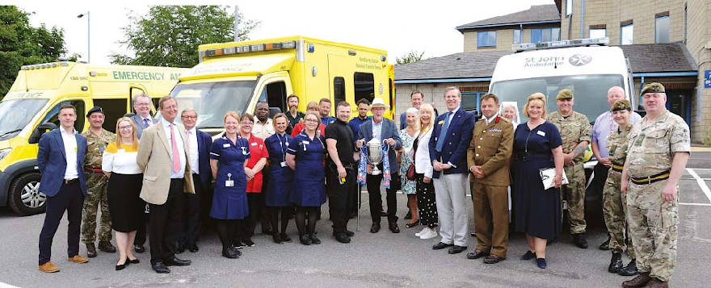
‘Together We Care’
Our Vision is ‘to provide an outstanding experience and best outcomes for patients and the team’
Our Values are ‘Patients First, Personal Responsibility, Passion for Excellent and Pride in our Team’ or the ‘4Ps’
Our Mission is ‘to ensure the provision of high quality, sustainable healthcare services to the communities we serve’
Notes:
This is just a little bit about the trust’s ethos.

Slide 3
About Our Trust
The trust is made up of three main hospital sites within Surrey:
  Ashford Hospital
  St Peter’s Hospital
  Woking Community Hospital
The trust does have some other satellite sites around the area.
The main site for Foundation Training is St Peter’s Hospital
Have recently started a group model with Royal Surrey
We use a Cerner based EPR.
Notes:
Ashford Hospital - The majority of planned care, like day case & orthopaedic surgery & rehabilitation services is provided at Ashford Hospital. New elective surgical centre
St Peter’s Hospital - More complex medical and surgical care and emergency services are provided at St Peter’s Hospital
Woking Community Hospital - Outpatient & rehabilitation services are provided at Woking Community Hospital, with Community Diagnostic Centre.
Main site for foundation is St Peters
Main centre of population serviced by the hospital are Woking, Weybridge, Staines-Upon Thames and Walton on Thames
Group Model with Royal surrey is to enable clinically-led improvements by enabling sharing best practice and standardising outcomes for patients

Slide 4
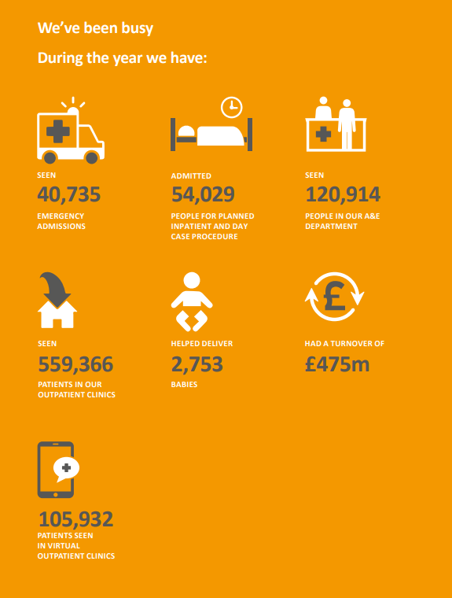
Notes:
This is just a little excerpt so you can see what the trust has done over the past year, as we are a busy NHS trust. We serve a population of over 410,000 from Runnymede, Spelthorne, Woking and parts of Elmbridge, Hounslow, Surrey Heath and beyond. We have a very wide demographic over these these areas, but due to our status as DGH, there is a large elderly inpatient cohort.

Slide 5
St Peter’s Hospital site
The main services that run from the St Peter’s site are:
  Accident & Emergency services
  Intensive care
  Emergency surgical and medical care
  Elective and day-case surgery
  Inpatient medical care
  Orthopaedics (Rowley Bristow unit)
  Maternity care
  Paediatric services
  Level 3 Neonatal intensive care unit & Surrey Neonatal Transport Service
  Outpatients and diagnostics:
    X ray, ultrasound, CT Scans, endoscopy and MRI scans
  Pathology services (part of BSPS)
  Note: Foundation Doctors are predominantly based at St Peter’s Hospital site.

Slide 6
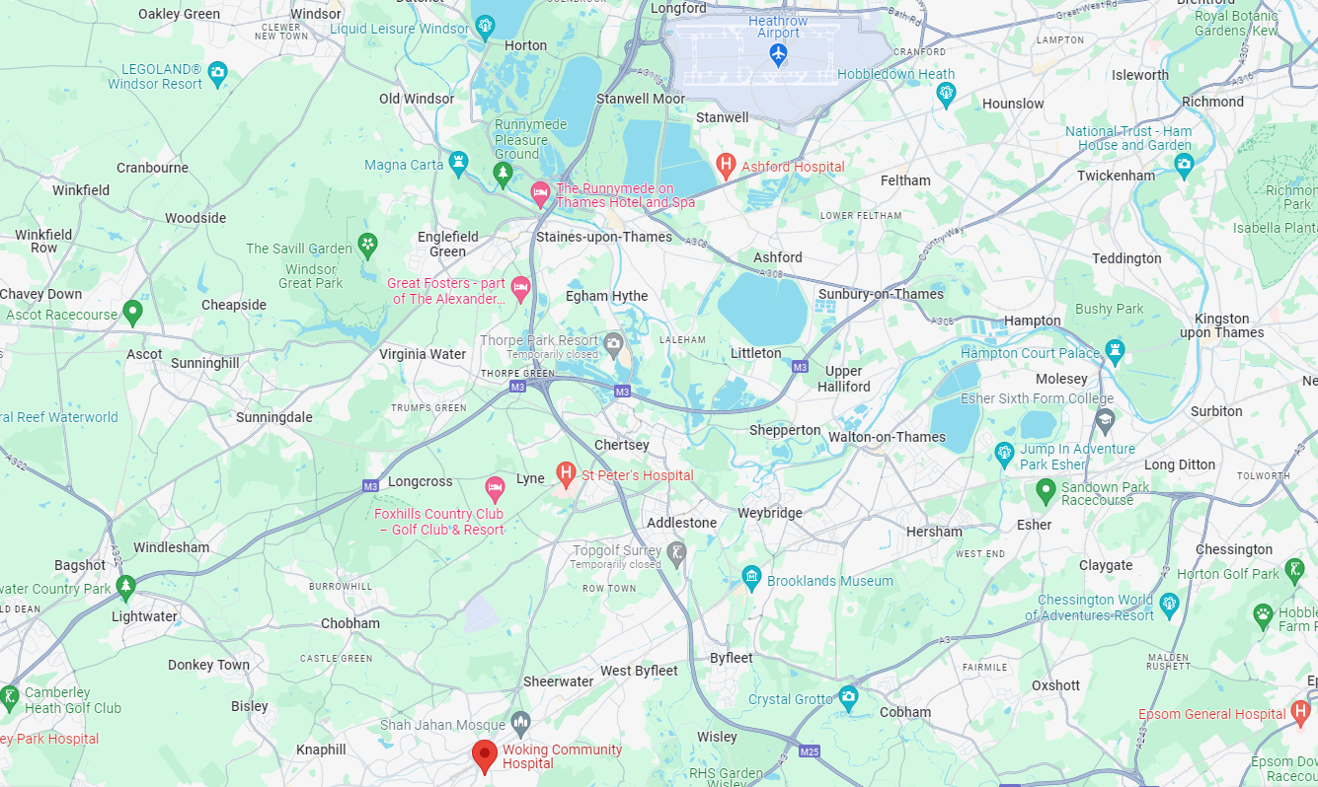
Notes:
Marked in red are our three main sites
Marked in Green are our colleagues at Frimley Park (west) & Epsom Hospitals (east) – Royal Surrey is due south of ‘Woking Community Hospital’
In Blue are points of interest. Lots of Beauty spots (Virginia Water, Kew Gardens, Wisley, Windsor Great Park) as well as some things to do on the weekend (Legoland, Thorpe Park, Chessington, Hampton Court Palace) as well as some nightlife in nearby towns.
Chertsey to Heathrow Airport is about a 20 minute drive, depending on traffic

Slide 7
Getting to St Peter’s
Public transport (it is possible)
  Chertsey/Woking Train Station
  446 Bus – Woking to Hatton Cross - £1 per journey
Driving
  Just off J11 of M25
  A320 North of Woking improvements
Parking
  £20.00 per year for the permit and
    £1.38 per day (for scratchcards) or £25.30 (monthly pay)
Car charging
Notes:
Be honest - St Peter’s itself isn’t the most accessible hospital site for transport, but there is now a bus for staff (the 446) between Hatton Cross & Woking Station, stopping at St Peter’s Hospital, passing through Ashford Hospital on the way. Costs £1 per journey, but this can be used at any time, including evenings and weekends, by showing a hospital ID card.
Main line train stations – including Chertsey & Woking
Junction 11 off M25 – there is increasing roadwork activity around the site, as part of the A320 North of Woking Improvements
Parking usually okay for most doctor shift times, but after 9am, can get difficult
Holding a permit does not guarantee a space
There are 6 charging points at Ashford Hospital and 8 at St Peter’s with a rate of 45p per kilowatt

Slide 8
Accommodation
On-site
  Recently built keyworker accommodation at St Peter’s site run by Southern Housing
Off-site
  At Ashford run by A2 Dominion Group
  At St Peter’s run by Vivid Homes
Dedicated Accommodation Officer
Notes:
On-site at St-Peters – Southern Housing
On-site at Ashford – A2 Dominion Group
Off-site – Vivid Homes
The trust has an accommodation officer who works for the HR team.

Slide 9
Foundation Team
Dr Clarence Chikusu, Director of Medical Education
Mr Salil Umranikar, Foundation Year 1 Programme Director, Consultant Urologist
Mr Senthy Sellaturay, Foundation Year 2 Programme Director, Consultant Urologist
Russell Varcoe, Foundation Programme Coordinator
Shri Dajee, Foundation Programme Aministrator
Notes:
Dr Clarence Chikusu was previously the trust’s Physician tutor and was appointed into the role of DME for about 8 months.
Mr Umranikar is in his 2nd year as F1 programme director.
Mr Senthy Sellaturay is our newest appointment as F2 programme director, but he is well supported and has a specific interest in coaching.
The clinical and non-clinical parts of the education team operate an open door policy, and there is always someone on site from 07:30-17:00 if you need to speak to someone about your training, wellbeing or other concerns.

Slide 10
Our Posts
Shadowing & Induction for F1 planned to start on Wednesday 29th July
Foundation Year One – 57 Posts
  Medicine focus but also
    Surgical
    Psychiatry
    Paediatrics
    Intensive Care
    Clinical Radiology
Foundation Year Two – 57 Posts
  Much more of a mix but can include
    Dermatology/Pathology
    Paediatrics
    Psychiatry
    Neurorehabilitation
    Obstetrics & Gynaecology
    Emergency Medicine
    General Practice
Notes:
We will have 57 F1 posts in all sorts of specialties, mostly with a focus on ‘Medicine’ Specialties but with some surgical, paeds & other posts.
We also have 57 F2 posts, which are again, in all sorts of specialties but include A&E, O&G and GP with some special interest posts

Slide 11
F1 Rotas
Information below is subject to change and is based on current rotas only
Intensive Care – Includes standard days, nights & late days
Clinical Radiology – Standard days in radiology. Medicine on-calls including nights, ward weekends, long day on call shifts and twilights
Orthogeriatrics (T&O) – Includes standard days and weekend shifts
Paediatrics – Basic standard days only
Palliative Care – Woking & Sam Beare Hospice – 2 months at hospice with standard days, 2 months at acute sites with standard days, weekend ward, long day, twilights and nights
Palliative Care – Princess Alice Hospice – 2 months at acute site with standard days, weekend ward, long days, twilights and nights, 2 months at hospice
Psychiatry – Standard days
Surgery – Standard days, surgery on-call, surgical ward cover, weekend ward cover, twilight ward cover
Medicine – Standard days, nights, ward weekend, long day on call, twilights
Works A&E Weekends:
  F2 General Practice
  F2 Dermatology/Pathology
  F2 Neurorehabilitation
Notes:
Some of our posts do include on-call or weekend rotas that are in a different specialty to the ‘named’ specialty.

Slide 12
Foundation Specific
Supervision
  An Educational Supervisor is allocated for the whole training year (or two years) to maintain overview of development & progress
  A Clinical Supervisor is allocated for each four month placement for local support
Taster Sessions
  We encourage Foundation doctors to take taster sessions in specialties other than those allocated for rotations – up to 5 days over the course of Foundation Training
Foundation Doctor Forum
  Reps are appointed for each Foundation Year & meetings held throughout the year when feedback can be given
Interim Reviews
  Every Foundation doctor is invited to an interim review meeting with the Education Team in January
Notes:
Educational supervisor remains with the doctor for two years. A separate Clinical Supervisor will still be given for each four month placement.
We encourage FYs to undertake tasters.
We provide the opportunity for all Foundation Doctors to meet with a clinical and non-clinical member of the education team (usually programme director & manager) in January/February, in order that everything is in place for ARCP in June, have a discussion about career opportunities and the chance to raise any concerns.
We appoint not only Year reps as leads for feeding back and communicating between the education team and the foundation cohort.

Slide 13
Foundation Teaching Programme
Fortnightly Rostered Core Teaching – this may be subject to change
  Separate F1 & F2 Teaching mapped to the Curriculum
  Presenters from inside & outside the hospital on a wide range of topics
  Careers Sessions for F1s & F2s built into teaching
  Wellbeing Sessions built into teaching
  Face to Face session takes place in the Lecture Theatre at St Peter’s (usually)
  Sessions are recorded and can be watched back using our teaching bank on our Education Centre Website
Simulation
  Sim Lab & Control Room at St Peter’s
  Clinical Skills Teaching room at St Peter’s
  Ongoing investment in Simulation Teaching & equipment
  Immersive Simulation equipment in Sim Lab & Seminar room
  Continual development of Simulation Faculty & simulated practice
  Plans for simulated ward at St Peter’s
Notes:
We run a very varied core teaching programme which is rostered. Currently this is fortnightly, alternate weeks for F1 and F2, that is curriculum mapped. Built into this are careers development sessions and wellbeing sessions.
We have an engaging, supportive and friendly simulation & clinical skills team at St Peter’s. Simulation is a strongly enforced part of our training programme, and we do try to have these as multi-disciplinary interprofessional learning.

Slide 14
ASPH Doctors Mess
Reintroduced Doctor’s Mess to St Peter’s site late 2025
Access to all resident doctors and any other doctor paying subscription fees
Has a quiet room for work with PCs and telephones
Has TV provided
A kitchen with microwave, fridges, freezer, hot water
Mess Committee have been investigating how they can improve the space going forward. Looking at new furniture, coffee machine.

Slide 15





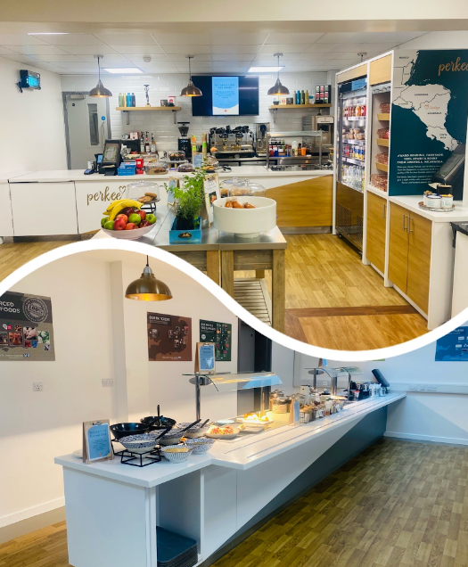
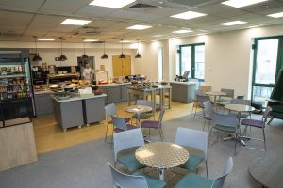
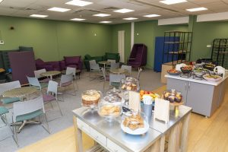

Health & Wellbeing & Other
Staff only food at the EDUkitchen and Ashford Wellbeing Hub
24/7 Hot Food & Vending in the Education Centre at St Peter’s
EDUkitchen at St Peter’s
Catering at Ashford
Notes:
The trust has a focus on wellbeing, and offers lots of different resources for all sorts of different types of wellbeing. Some pictured here are
Stream, which allows access to some of your wage early and other money ‘stuff’
Vivup, which is the trusts staff benefits platform & is the way the Employee Assistance Programme is accessed
There are may different EDI networks that you can be part of
The ‘star of the month’ award that recognises individual contribution on a monthly basis
Other things through the year including events, rounders tournament each year, competitions through the year all the way through to Psychological Incident debriefs
There are other things that the health and wellbeing team do, including provide on-site pastoral support.
Also here a little bit about our award winning food, there is staff only areas at both Ashford & St Peter’s for food, pictured here.

Slide 16
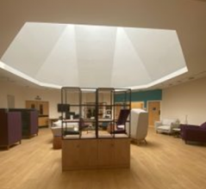
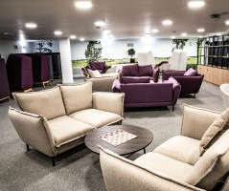
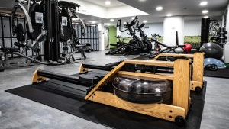
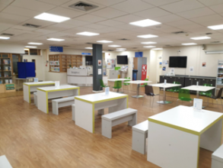
Health & Wellbeing & Other (cont)
Wellbeing Hub at Ashford
Wellbeing Hub at St Peter’s
Free staff gym at St Peter’s
EDUkitchen seating area
Notes:
Just some photos (albeit not the best quality) here to show you the wellbeing hubs, Gym @ SPH, and the seating in the Edukitchen

Slide 17





Knowledge Service
Expert Team of Staff Online Service Physical Libraries
Online resources include:
BMJ Best Practice; E-Books; Clinical Skills; E-Journals; BMJ Case Reports; Up-to-date; Oxford Medicine Online
Enquiries Service Evidence Search Service
Books to borrow to support:
Clinical Practice; Education; Professional Development; Health & Wellbeing
Current Awareness Service
Notes:
Although our hospital’s no longer have physical libraries, there is still a knowledge service that runs over both sites. We have maintained Study Spaces at both sites, with PCs that are accessible 24/7. The knowledge service team are able to help with evidence searching, and can help you with online resources and can still source physical books if required.

Slide 18
Medical Workforce
Rest Facilities
  Onsite Flat through Southern Housing for Resident Doctors who require rest facilities due to tiredness following a night shift or a long, late shift
  Two single bedrooms, bathroom, living space, kitchen, linen, towels & WIFI
Relocation Expenses
  Can be paid for removal of personal/ household effects, house sale/purchase costs and continuing commitments
On-site Occupational Health
  Pre-Placement health screening
  Risk / Environmental Assessments
  Immunisation programmes
  Rehabilitation after sickness or injury
  Health Promotion
  Health surveillance
  Management of, Needlestick, sharps, human bites and contamination accidents
Medical Workforce contact email address:
asp-tr.medicalworkforce@nhs.net
Notes:
Medical Workforce handle all aspects of your employment that do not pertain to your training. This includes rostering, leave (outside of Study Leave), travel/relocation expenses that are not associate with Study, rest facilities, work scheduling, contracts.

Slide 19
Q&A
We welcome your questions now, or at a later date:
Contact Russell Varcoe: russell.varcoe@nhs.net
Website (education): https://education.asph.nhs.uk/
Website (trust): https://www.ashfordstpeters.nhs.uk/

