Slide 1



Welcome to ESHT
Comprising of Eastbourne DGH, the Conquest Hospital and three community hospitals: Bexhill, Rye and Uckfield
Over 100 community sites across East Sussex, and in people’s own homes
The only integrated provider of acute and community care in Sussex
Over 7,000 dedicated members of staff
One of the largest organisations in East Sussex, annual income of £568 million
Conquest Hospital and our Community Services were rated ‘Outstanding’ and Eastbourne DGH was rated ‘Good’ – Care Quality Commission 2020
Part of the Sussex Health and Care Integrated Care System (ICS)

Slide 2
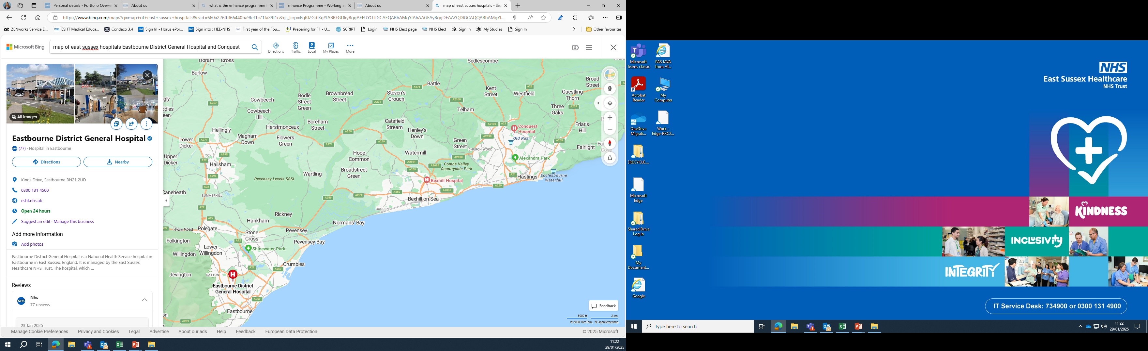
Hospital Locations
London
Kent – Rye, Ashford, Dover
Brighton

Slide 3
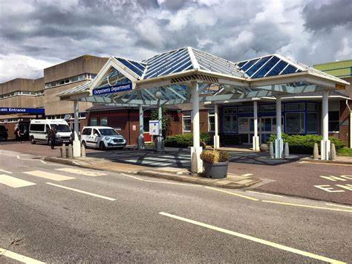
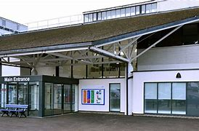
Eastbourne District General Hospital &
Conquest Hospital
Both main sites include:
24 hour a day care, offering a comprehensive range of surgical, medical, outpatient and maternity services, supported by a full range of diagnostic and therapy services
Emergency department
Education Centre
Library accessible 24/7
Doctors’ Mess also offering a range of social events
Canteen, coffee shop and gift shop
Onsite Nursery
Specialises in medical services including Urology, Haematology, ENT and Stroke
EDGH
Extensive obstetrics, surgical and trauma services
Grounds with large pond and picnic area
Conquest

Slide 4





Parking & Public Transport
Parking
Trains
Buses
Low cost parking permit approximately £100 per year, staff parking available at both sites.
Apply for a permit through the staff extranet when employed at ESHT.
Direct services to Brighton, London and Ashford.
Nearest stations:
EDGH – Hampden Park (walk 20-25 mins or bus journey to hospital)
Conquest – Hastings (bus journey to hospital)
Serving town centres, train stations and other local towns as well as a connection to Brighton from EDGH.

Slide 5
Accommodation
On-site accommodation available for rent (and for on-call nights) at both sites, subject to availability on ‘First Come First Served’ basis.
Flats with shared kitchen, bathroom and communal living room.
For cost details and availability please contact:
esht.accommodationconquest@nhs.net
esht.accommodationedgh@nhs.net

Slide 6

FY1 Induction & Shadow Week
Extensive induction and shadowing of a current FY1 during the last week of July, and the first Monday and Tuesday in August to prepare you for your first day as an FY1.

Slide 7
Rotations include three of the following specialities:
Psychiatry
Diabetes & Endocrinology
Rheumatology
Palliative Medicine
Paediatrics
Respiratory
Cardiology
Gastroenterology
Urology
Breast Surgery
ENT
Frailty
ITU
Stroke Medicine
General Surgery
Orthogeriatrics
Acute Medicine
Elderly Medicine

Slide 8

FY1 Teaching Opportunities
Weekly Core Teaching
Workshops
Grand Rounds
Departmental Teaching/bedside teaching
Self-Directed and Personal Learning
Structured Appraisals and Assessment
Teach/Mentor Medical Students
Simulation
LEAP
Enhance Programme
Emergency Medicine Ultrasound
Observation of ATLS/Paces/CRISP
Horus e-portfolio
Virtual Reality
ILS
You will also have a dedicated consultant Educational Supervisor for the year and Clinical Supervisors each placement.

Slide 9
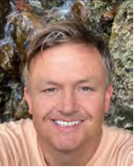
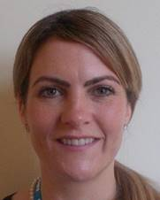

Wellbeing & Support
Pastoral Fellows
ESHT Staff
Available to all:
Multi-faith chaplaincy
People engagement team
Occupational health
Equality, Diversity & Inclusion tea,
On-site childcare facilities
Freedom to speak up guardian
Vivup
Dedicated pastoral support from Paul (EDGH) and Jolie (Conquest) as well as organisation of social events and stocking of Doctors’ mess.
https://www.esht.nhs.uk/working-for-us/health-and-wellbeing/

Slide 10
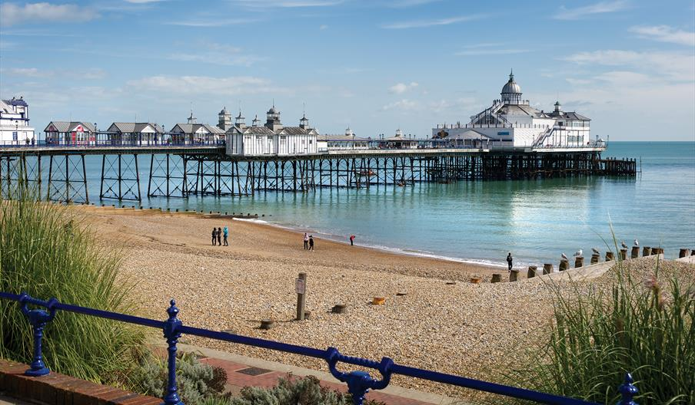
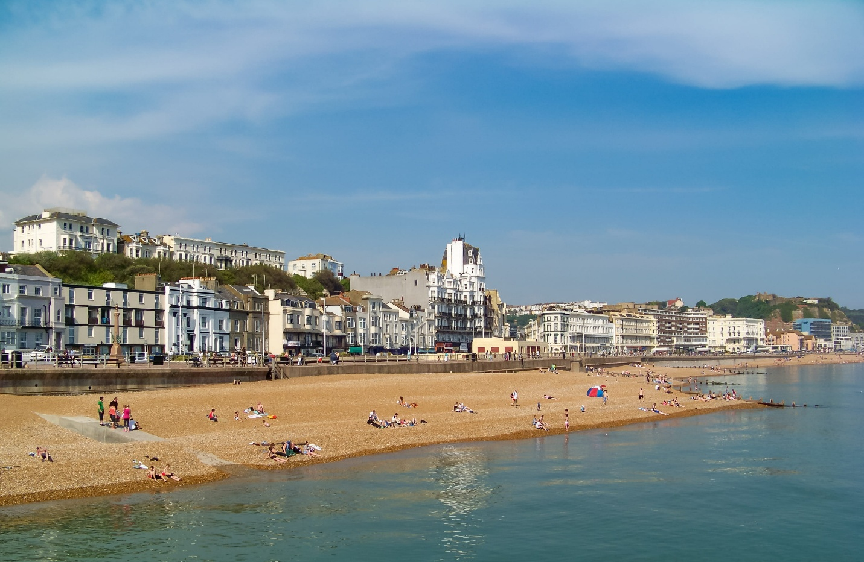
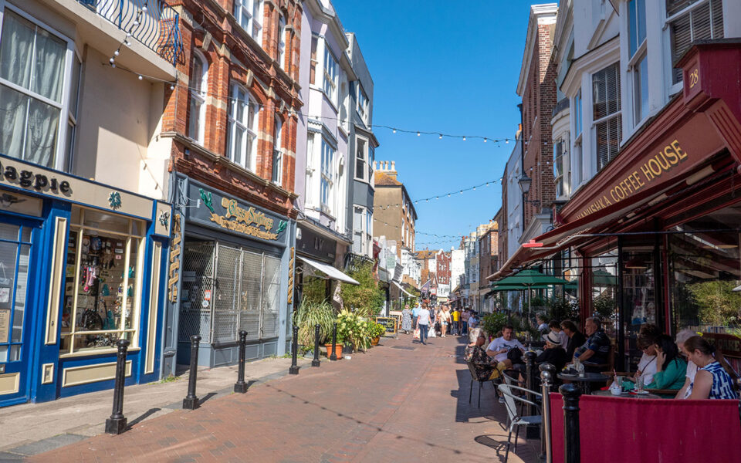
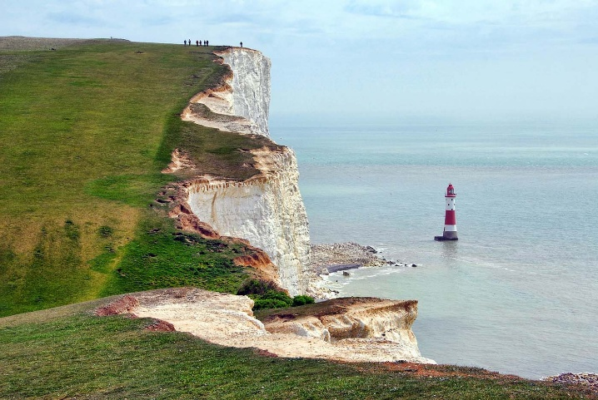

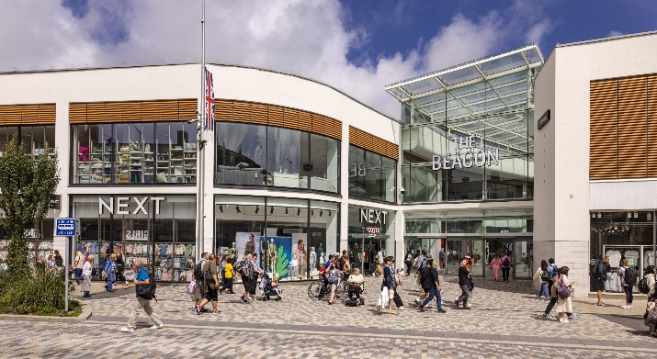
What's on in Eastbourne & Hastings
www.visit1066country.com
www.visiteastbourne.com

Slide 11
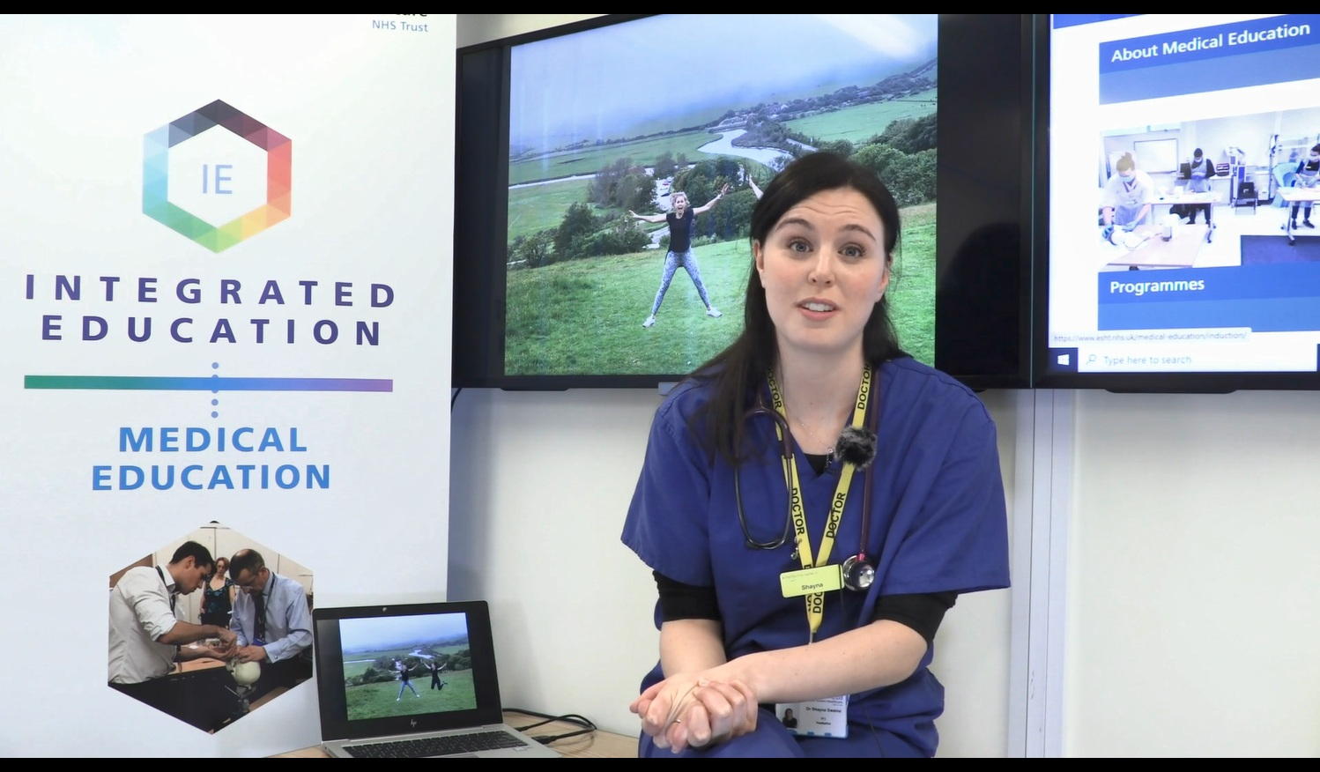
Further Information
Please watch the FY1 at ESHT video for further information:
https://www.youtube.com/watch?v=k9yy1GKw1HE
ESHT website: https://www.esht.nhs.uk/
ESHT Medical Education website: https://www.esht.nhs.uk/medical-education/

Slide 12

We would love to answer any queries that you may have.
Any questions?
If something comes to mind later, contact us on:
v.parslow@nhs.net (EDGH) or julie.deeprose@nhs.net (Conquest)

