Slide 1
FOUNDATION PSYCHIATRY in SPFT
KSS WELCOME EVENT 2025

Slide 2
Dr Stavros Bekas MD MSc MA FHEA
Foundation Programme Lead Tutor
Lead Psychiatrist, Adult Services East Sussex

Slide 3
The Aims of the Foundation Programme
The UK Foundation Programme is designed to support the transition from medical student to a doctor that is:
an accountable, capable and compassionate clinician;
a valuable member of healthcare workforce and;
a professional, responsible for their own practice and portfolio development.
These form the three Higher Level Outcomes (HLOs) of the Foundation Programme.

Slide 4
Sussex Partnership NHS Foundation Trust
All ‘psychiatry’ placements in the Sussex KSS area are offered here
Child and adolescent mental health services (CAMHS)
Community based services
Inpatient services
Specialist older adults and dementia services
Specialist services
Urgent care services
Hospitals Units

Slide 5
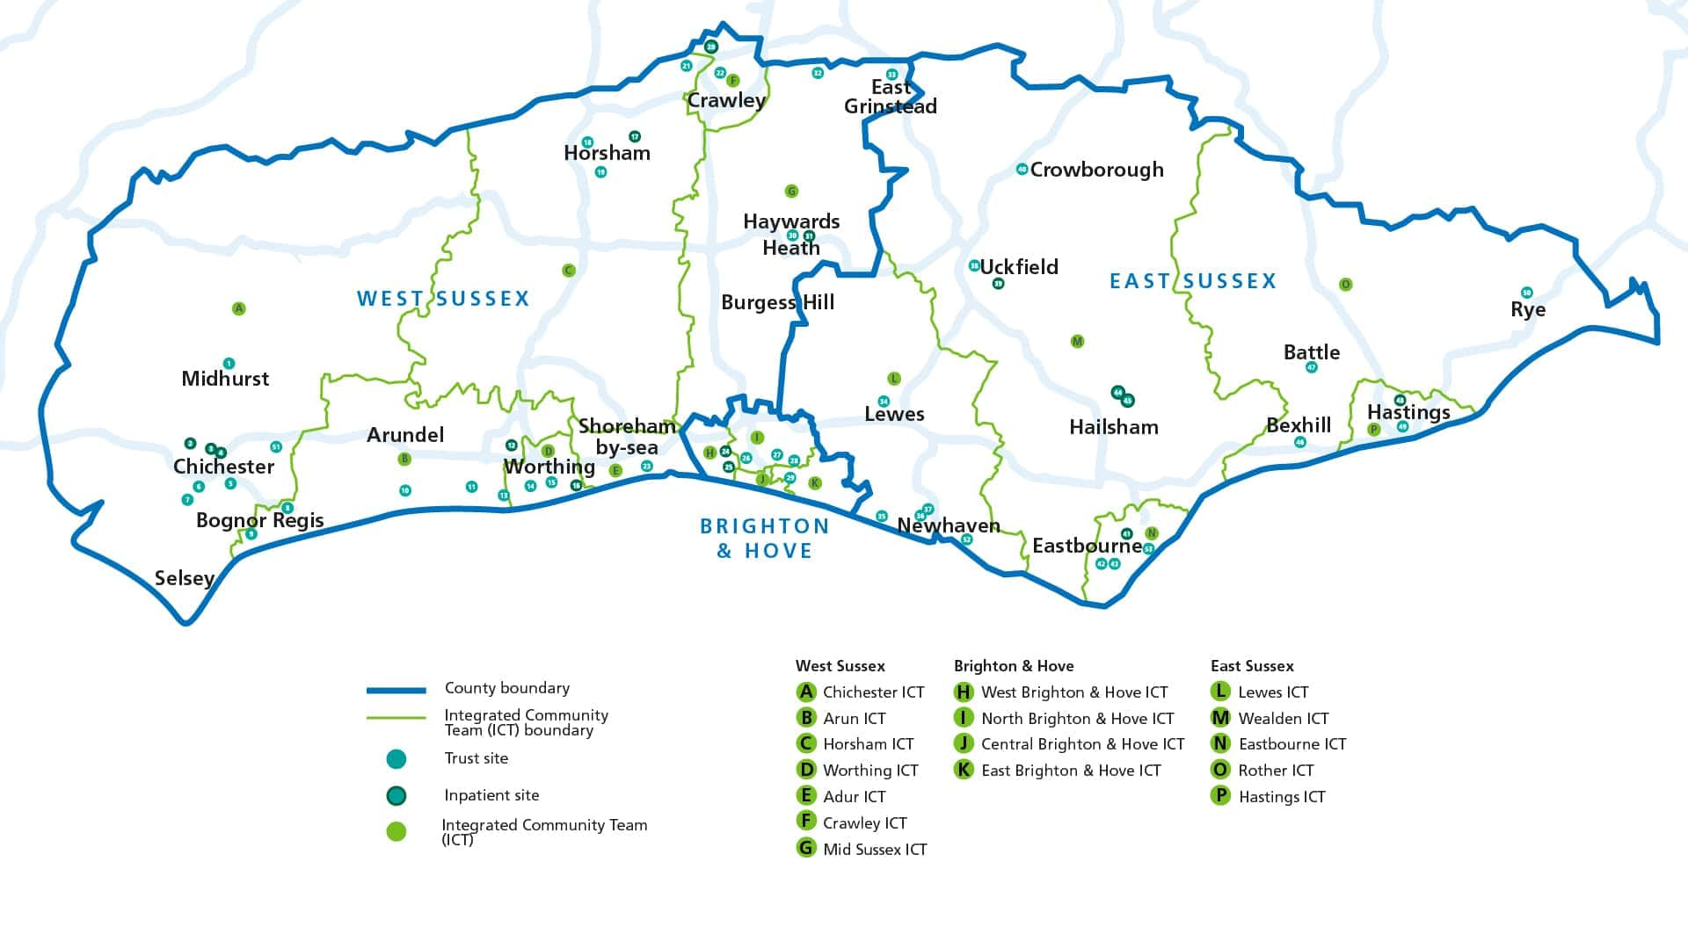
Our sites and locations

Slide 6
Why psychiatry?
Mental Illness prevalence
Integration and Community emphasis
Generic, transferable skills
Careers and Recruitment

Slide 7
Why psychiatry?
Good medical practice and the foundation doctor - covers a lot of the Curriculum based on the General Medical Council’s (GMC) documents
Build on undergraduate education - by instilling recently graduated doctors with the attributes of professionalism and the primacy of patient welfare, with both acute and long-term conditions

Slide 8
Why psychiatry?
Provides generic training that ensures foundation doctors develop and demonstrate a range of essential interpersonal and clinical skills for managing patients with both acute and long-term conditions, regardless of the specialty
Provides a variety of workplace experience during your foundation programme in order to best inform career choice.

Slide 9
The ‘parity of mental health’ and the importance of social wellbeing emphasises the importance of mental and social wellbeing on physical health and lists explicitly the areas of mental health in which FDs should acquire competence:
Depression
Mania
Psychosis
Anxiety/panic
Personality disorder
Delirium, dementia
Eating disorders

Slide 10
Addictions
Somatisation disorders, including functional syndromes
Assessing capacity and using Mental Capacity Act;
Mental Health Act 1983
Relevant ethical framework around difficult decision-making,
Understanding that physical disease can present with psychiatric symptoms
Serious adverse effects of common psychotropic medications
Communicating with and managing a disturbed or challenging patient
Manage risk - mental health patients to themselves and to others
Explaining a diagnosis to a patient (or carer) who has Medically Unexplained Symptoms (MUS) or a non-organic cause for their symptoms, e.g. panic disorder presenting as chest pain.

Slide 11
RCPsych anticipates you should be able to:
Elicit a basic clinical history for a common psychiatric disorder
Perform a mental state examination for a common psychiatric disorder
Perform a cognitive screening assessment
Perform a risk assessment
Make a concise case presentation and initial management plan for a common
Psychiatric disorder
Write an accurate and concise report, assessment or referral

Slide 12
Extras
Shadowing other services within psychiatry
On calls for some (eventually all F2s)
Tasters that come out of study leave usually re approved
F1 Posts will allow acute ‘in-touch’ sessions along with regular Foundation teaching to develop the generic clinical competencies and do procedures
Different ways of achieving this by each Acute Trust e.g. F1 to join the acute floor clerking team, A&E or weekend on calls;
All Foundation doctors have 2 hours ‘personal development’ time per weekly schedule

Slide 13
Contact
S.Bekas@nhs.net

Slide 14
Thank you for your time

