Slide 1

Welcome to
East Sussex
Healthcare
NHS Trust
Comprising of Eastbourne DGH, The Conquest Hospital and three community hospitals: Bexhill, Rye and Uckfield
Over 100 community sites across East Sussex, and in people’s own homes
The only integrated provider of acute and community care in Sussex
Over 7,000 dedicated members of staff
One of the largest organisations in East Sussex, annual income of £568 million
Conquest Hospital and our Community Services were rated ‘Outstanding’ and Eastbourne DGH was rated ‘Good’ – Care Quality Commission 2020
Part of the Sussex Health and Care Integrated Care System (ICS)

Slide 2
Our Last Year
Our last year
160,000 attendances at our Emergency Departments
2,749 babies were born in our hospitals
56,000 people had planned surgery, 90% of these were day cases
21,800 cancer referrals were made to us
41,000 referrals to community nursing, 96% seen within 24 hours
470,000 outpatient appointments
10.2 million pathology tests
1907 patients took part in clinical research
1,109,000 patient meals were prepared across the 4 main hospitals
542,550 medicines were dispensed by the pharmacy

Slide 3
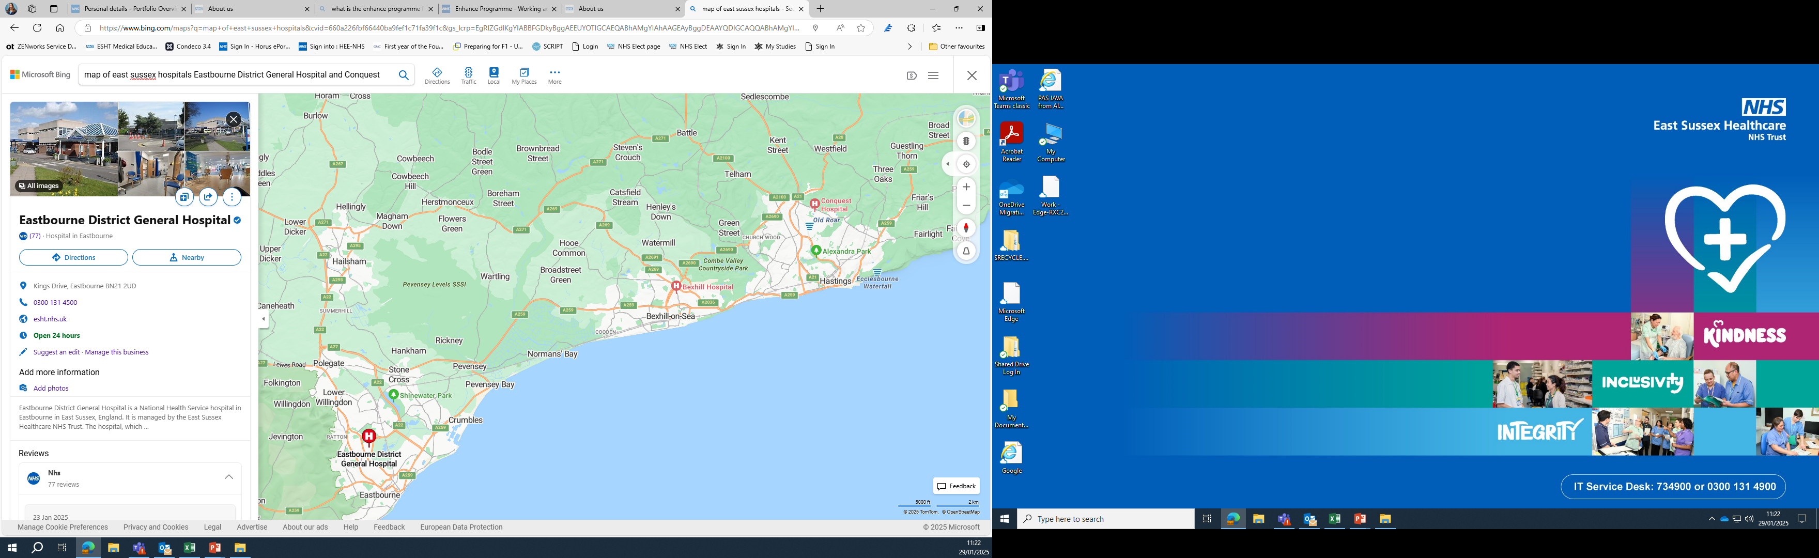
Hospital Locations
2 acute hospitals: The Conquest in Hastings and Eastbourne DGH

Slide 4
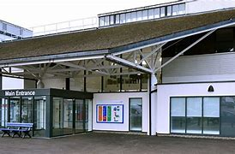
Conquest Hospital
Emergency department
24 hour a day care, offering a comprehensive range of surgical, medical, outpatient and maternity services, supported by a full range of diagnostic and therapy services.
The Conquest Hospital is also the centre for Trauma Services and Obstetrics
Drs Mess with a range of social activities
There is also a canteen, 1066 Café and gift shop
We also have a large pond and picnic area
24 hour Library
Education Centre

Slide 5
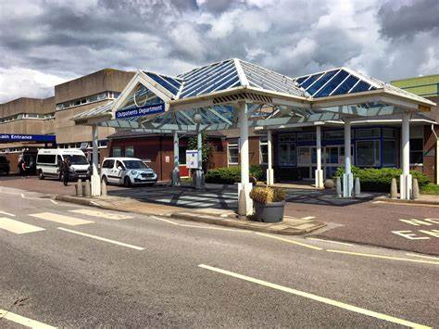
Eastbourne District General Hospital
Emergency department
24 hour a day care, offering a comprehensive range of surgical, medical, outpatient and maternity services, supported by a full range of diagnostic and therapy services.
Eastbourne also provides Urology, Haematology, ENT and Stroke Services.
Canteen, League of Friends shop and Coffee shop
Education Centre
Library
Drs Mess also offering a range of events
Social Club

Slide 6
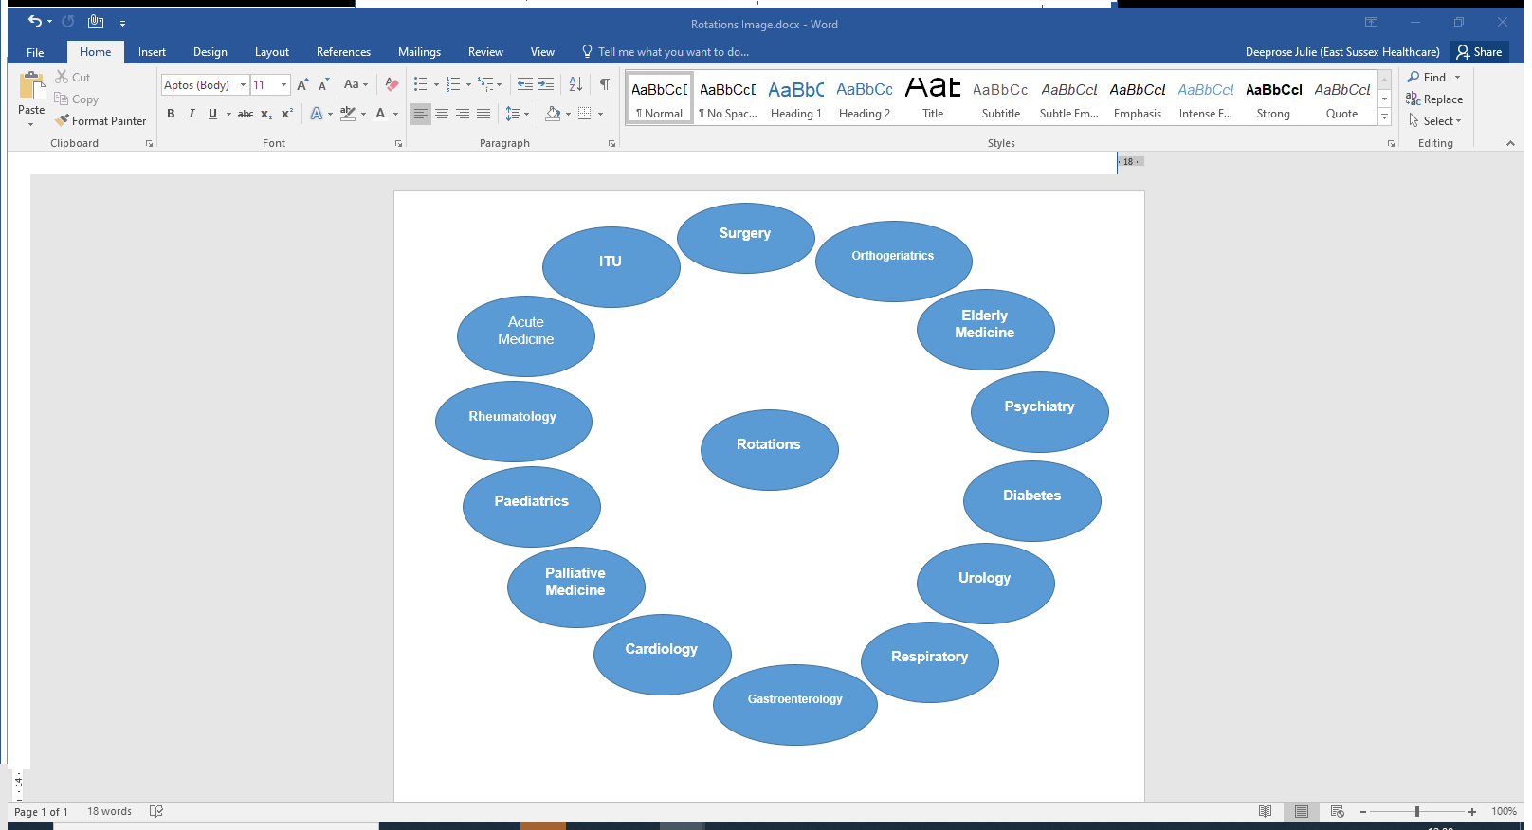
Rotations include Three of the following specialties

Slide 7
Parking and Public Transport at Eastbourne and the Conquest
Low cost parking permit approximately £50 per year, staff parking available at both sites
Apply for a permit through the staff extranet
Trains: Nearest station to Eastbourne Hospital is Hampden Park. You will need to get a bus from the station.
Nearest station to the Conquest is Hastings Station. You will need to get a bus from the station.
For the latest train travel information contact www.nationalrail.com or www.thetrainline.com
Buses: For the latest bus travel information contact Stage Coach contact Buses are run by Stage Coach at www.stagecoachbus.com
Buses that run regularly from the hospital from the train station include 100, 321, 323, 329A.

Slide 8
FY1 Teaching and Learning Opportunities
Weekly Core Teaching
Workshops
Grand Rounds
Departmental Teaching/bedside teaching
Self-Directed and Personal Learning
Structured Appraisals and Assessment
Teach/Mentor Medical Students
Simulation
LEAP
Enhance Programme
Emergency Medicine Ultrasound
Observation of ATLS/Paces/CRISP
Horus e portfolio
Virtual Reality
ILS

Slide 9

FY1 Shadowing and Induction Week
Monday to Friday during the last week in July, and the first Monday and Tuesday in August, we have a full programme of induction events and shadowing a current FY1 to prepare for starting FY1 on the first Wednesday in August

Slide 10
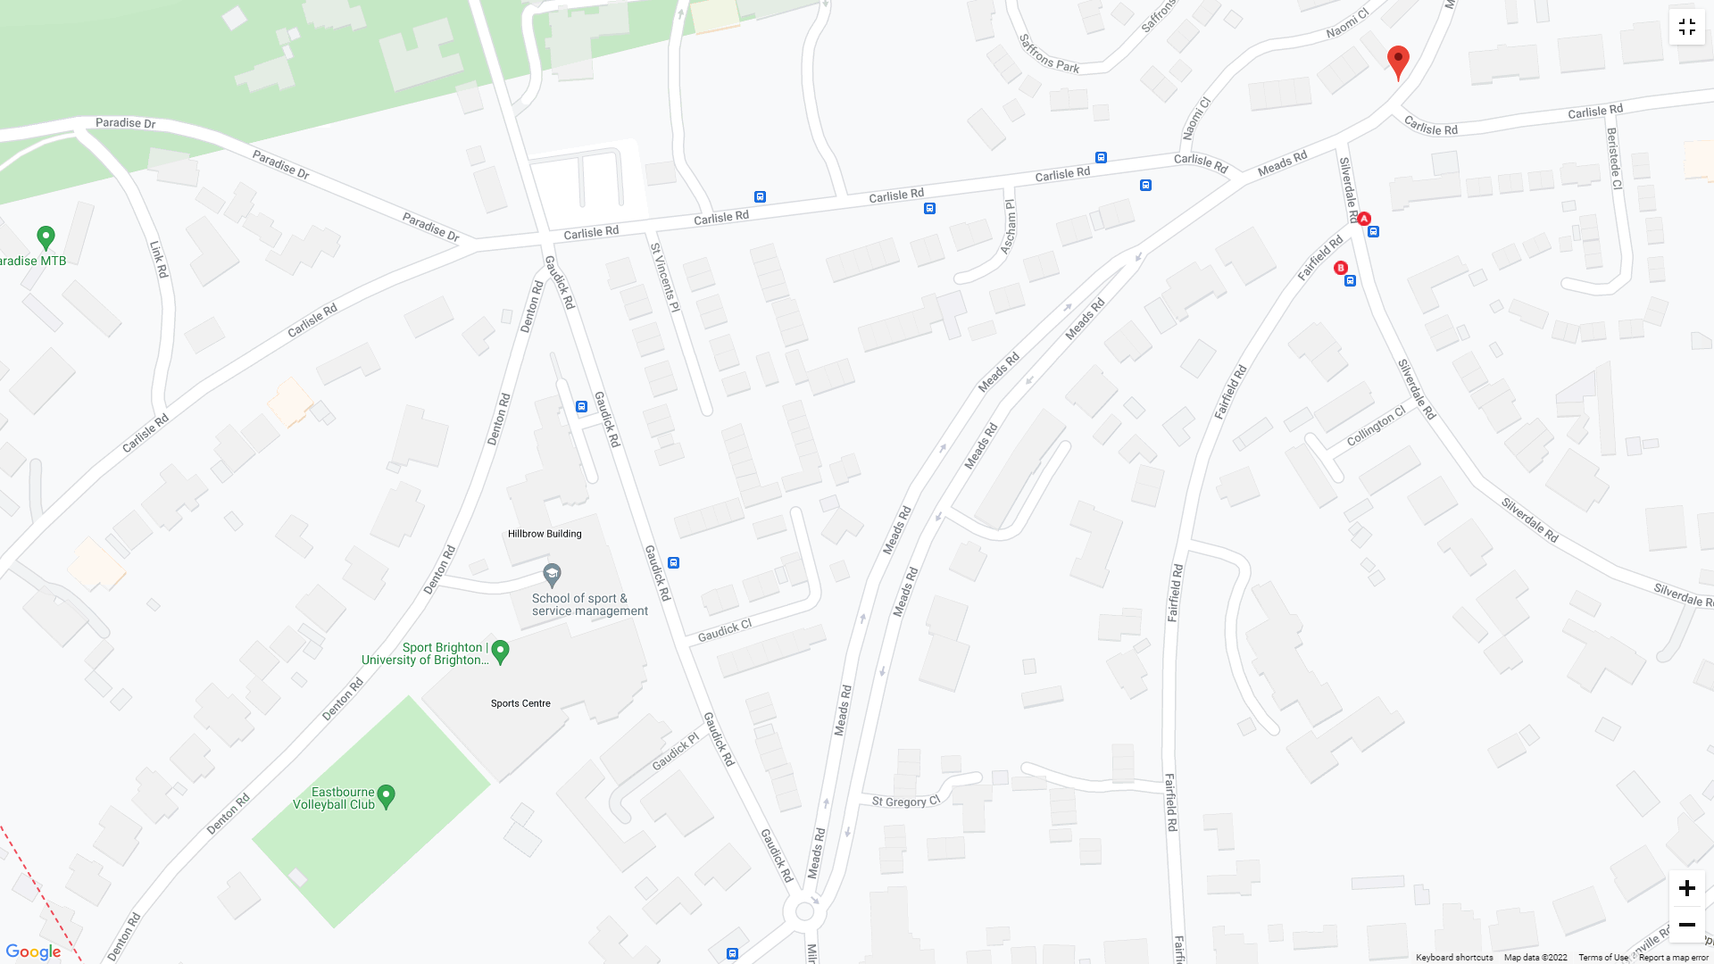
Accommodation in eastbourne
Eastbourne: Offsite at Welkin Halls, Guadick Road, BN20 7SH. Private en suite rooms available within a 5-6 bedroomed flat share.
For cost details and availability please contact esht.accommodationwelkin@nhs.net

Slide 11
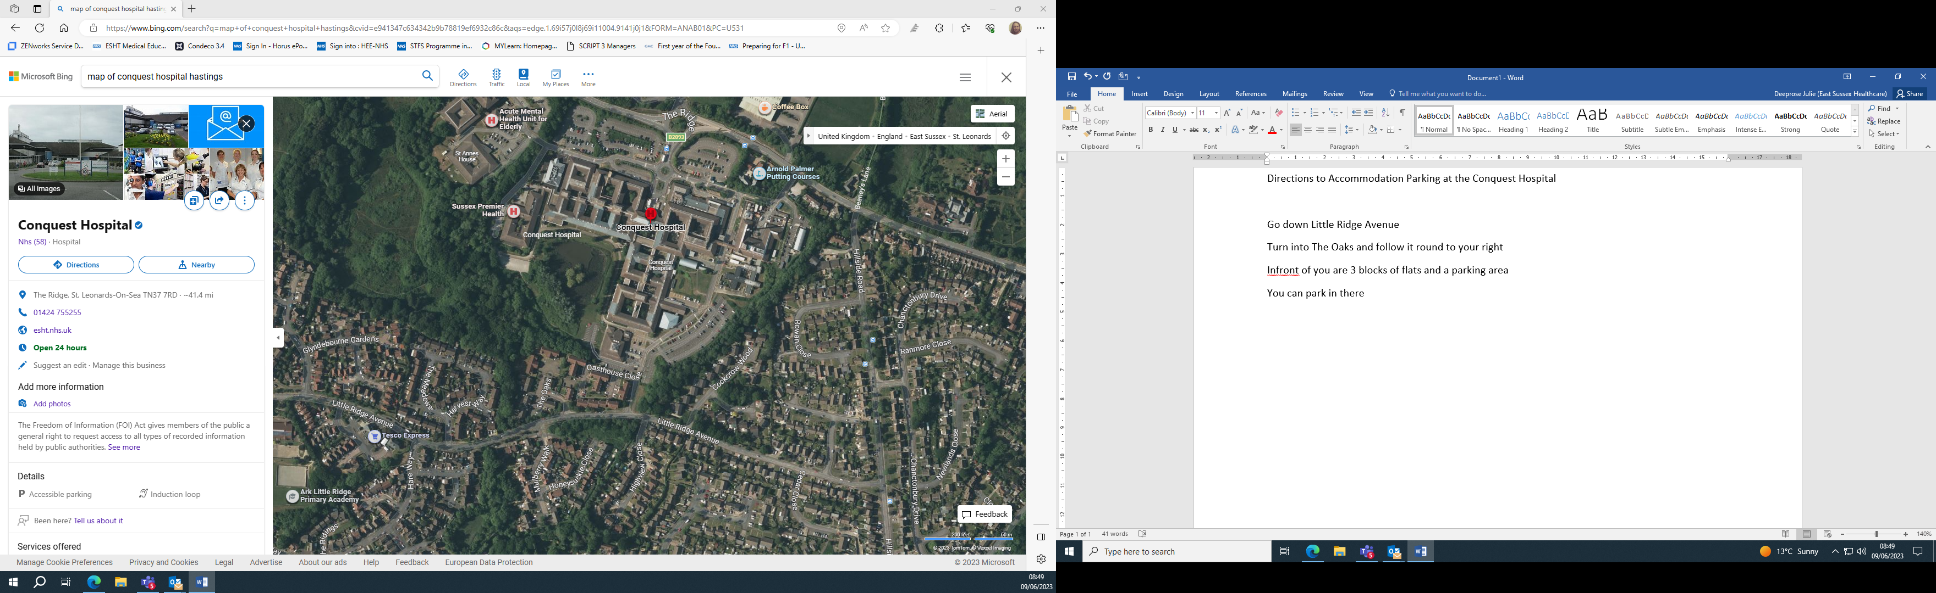
Accommodation at the Conquest Hospital
Conquest: Onsite accommodation: Oast House Close, The Oaks, Little Ridge Avenue, St Leonards-On-Sea, TN37 7UY, 5 bedroom flats with shared kitchen, bathroom and communal living room and some family accommodation
For cost details and availability please contact esht.accommodationconquest@nhs.net

Slide 12
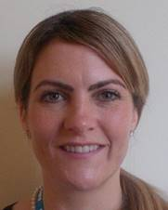



Support for Junior Doctors at ESHT:
Care First / Our Values
Pastoral Fellows:
(Jolie Wilkinson Conq)
(Paul Gosling EDGH)
& Chaplaincy Team
Dedicated Educational
& Clinical Supervisors

Slide 13

Further Support available for all staff
People Engagement Team
Occupational Health
Equality Diversity and Inclusion team
Onsite childcare facilities
Freedom to Speak up Guardian
Vivup
https://www.esht.nhs.uk/working-for-us/health-and-wellbeing/

Slide 14
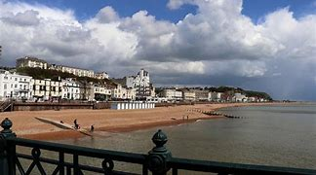
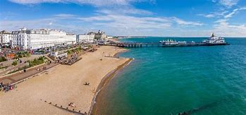
What's on in Hastings www.visit1066country.com
What's on in Eastbourne
www.visiteastbourne.com

Slide 15
Further Information
Please watch the FY1 at ESHT video for further information:
https://www.wevideo.com/view/3721701781

Slide 16

Q & A
We would love to answer any queries that you may have

