Slide 1
KSS F1 Welcome Event Ashford & St Peter’s Hospitals

Slide 2
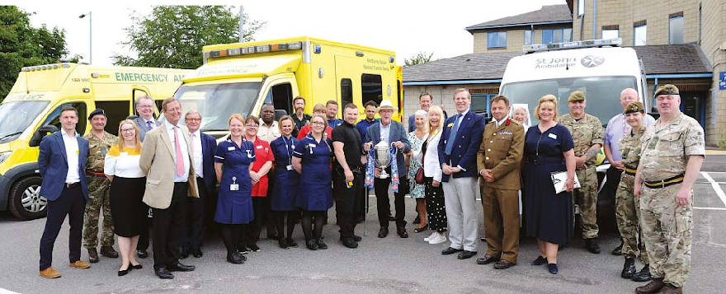
‘Together We Care’
Our Vision is ‘to provide an outstanding experience and best outcomes for patients and the team’
Our Values are ‘Patients First, Personal Responsibility, Passion for Excellent and Pride in our Team’ or the ‘4Ps’
Our Mission is ‘to ensure the provision of high quality, sustainable healthcare services to the communities we serve’

Slide 3
About Our Trust
The trust is made up of three main hospital sites within Surrey:
Ashford Hospital
St Peter’s Hospital
Woking Community Hospital
The trust does have some other satellite sites around the area.
The main site for Foundation Training is St Peter’s Hospital

Slide 4
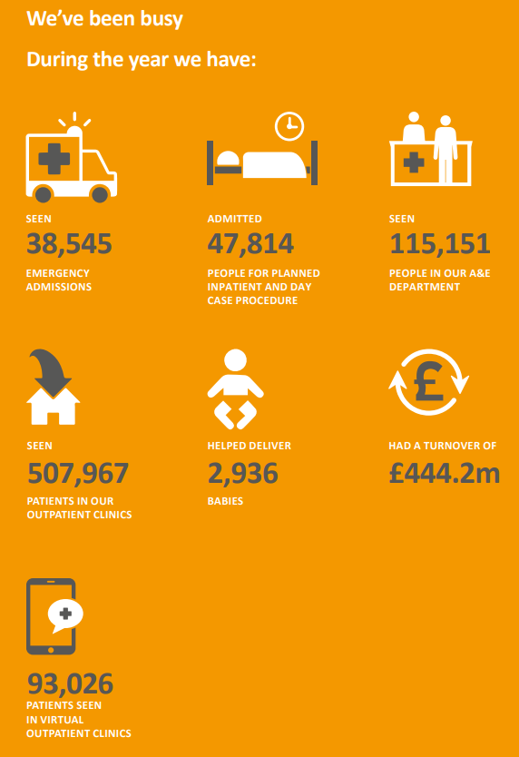

Slide 5
St Peter’s Hospital site
The main services that run from the St Peter’s site are:
Accident & Emergency services
Intensive care
Emergency surgical and medical care
Elective and day-case surgery
Inpatient medical care
Orthopaedics (Rowley Bristow unit)
Maternity care
Paediatric sevrices
Level 3 Neonatal intensive care unit & Surrey Neonatal Transport Service
Outpatients and diagnostics:
X ray, ultrasound, CT Scans, endoscopy and MRI scans
Pathology services
Note: Foundation Doctors are predominantly based at St Peter’s Hospital site.

Slide 6
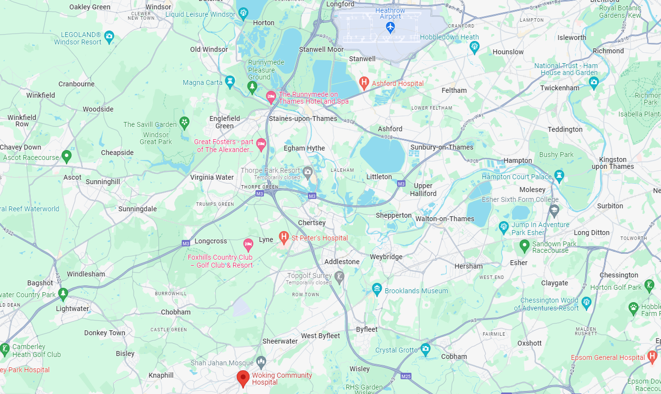

Slide 7
Getting to St Peter’s
Public transport (although possible)
Chertsey/Woking Train Station
446 Bus – Woking to Hatton Cross
Driving
Just off J11 of M25
Parking
£20.00 per year for the permit and
F1 - 58p per day (for scratchcards) or £10.55 (monthly pay)
F2 - £1.15 per day (for scratchcards) or £21.08 (monthly pay)
Car charging

Slide 8
Accommodation
On-site
Off-site
Accommodation Officer
Low availability
New Keyworker housing being built – finishing in Spring/Early Summer

Slide 9
Foundation Team
Mr Phil James, Clinical Tutor (Director of Medical Education)
Mr Salil Umraniker, Foundation Year 1 Programme Director, Consultant Urology
Mr Nim Arumainayagam, Foundation Year 2 Programme Director, Consultant Urologist
Russell Varcoe, Foundation Programme Coordinator
Shri Dajee, Foundation Programme Aministrator

Slide 10
Our Posts
Foundation Year One – 53 Posts
Medicine focus but also
Surgical
Psychiatry
Paediatrics
Intensive Care
Clinical Radiology
Foundation Year Two – 54 Posts
More of a mix but can include
Dermatology/Pathology
Paediatrics
Psychiatry
Neurorehabilitation
Obstetrics & Gynaecology
Emergency Medicine
General Practice

Slide 11
F1 Rotas
Information below is subject to change and is based on current rotas only
Anaesthetics – Includes standard days, nights & late days
Clinical Radiology – Standard days in radiology. Medicine on-calls including nights, ward weekends, long day on call shifts and twilights
Orthogeriatrics (T&O) – Includes standard days and weekend shifts
Paediatrics – Basic standard days only
Palliative Care – Woking & Sam Beare Hospice – 2 months at hospice with standard days, 2 months at acute sites with standard days, weekend ward, long day, twilights and nights
Palliative Care – Princess Alice Hospice – 2 months at acute site with standard days, weekend ward, long days, twilights and nights, 2 months at hospice
Psychiatry – Standard days
Surgery – Standard days, on-call, surgical ward cover, weekend ward cover, twilight ward cover
Medicine – Standard days, nights, ward weekend, long day on call, twilights
Works A&E Weekends:
F2 General Practice
F2 Dermatology/Pathology
F2 Neurorehabilitation

Slide 12
Foundation Specific
Supervision
An Educational Supervisor is allocated for the whole training year (or two years) to maintain overview of development & progress
A Clinical Supervisor is allocated for each four month placement for local support
Taster Sessions
We encourage Foundation doctors to take taster sessions in specialties other than those allocated for rotations – up to 5 days over the course of Foundation Training
Foundation Doctor Forum
Reps are appointed for each Foundation Year & meetings held throughout the year when feedback can be given
Interim Reviews
Every Foundation doctor is invited to an interim review meeting with the Education Team in January
Teaching Opportunities
Assigned Undergraduate Teaching Affiliate role

Slide 13
Foundation Teaching Programme
Fortnightly Rostered Core Teaching
Separate F1 & F2 Teaching mapped to the Curriculum
Presenters from inside & outside the hospital on a wide range of topics
Careers Sessions for F1s & F2s built into teaching
Wellbeing Sessions built into teaching
Face to Face session takes place in the Lecture Theatre at St Peter’s (usually)
Sessions are recorded and can be watched back using our teaching bank on our Education Centre Website
Simulation
Sim Lab & Control Room at St Peter’s
Clinical Skills Teaching room at St Peter’s
Ongoing investment in Simulation Teaching & equipment
Immersive Simulation equipment in Sim Lab & Seminar room
Continual development of Simulation Faculty & simulated practice
Plans for simulated ward at St Peter’s

Slide 14
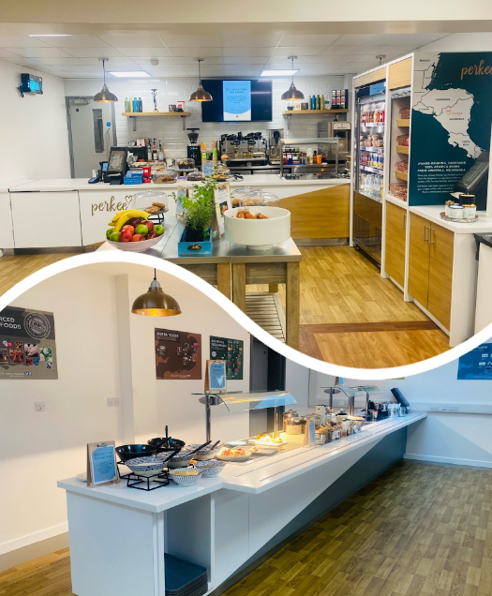
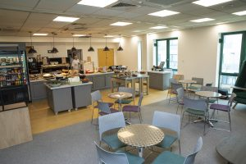
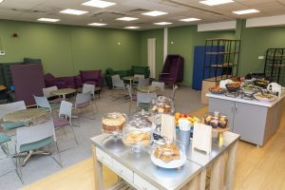
Health & Wellbeing & Other
Staff only award winning food at the EDUkitchen and Ashford Wellbeing Hub
24/7 Hot Food & Vending in the Education Centre at St Peter’s
EDUkitchen at St Peter’s
Catering at Ashford

Slide 15
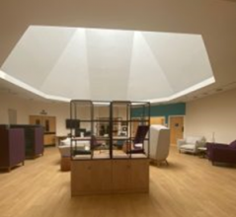
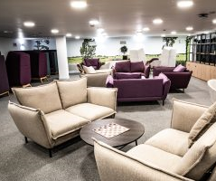
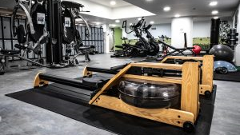
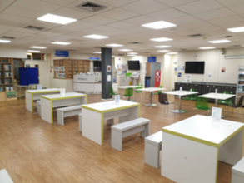
Health & Wellbeing & Other (cont)
Wellbeing Hub at Ashford
Wellbeing Hub at St Peter’s
Free staff gym at St Peter’s
EDUkitchen seating area

Slide 16
Knowledge Service
Expert Team of Staff Online Service Physical Libraries
Online resources include:
BMJ Best Practice; E-Books; Clinical Skills; E-Journals; BMJ Case Reports; Up-to-date; Oxford Medicine Online
Enquiries Service Evidence Search Service
Books to borrow to support:
Clinical Practice; Education; Professional Development; Health & Wellbeing
Current Awareness Service

Slide 17
Medical Workforce
Rest Facilities
Onsite Flat through Optivo for Doctors in training who require rest facilities due to tiredness following a night shift or a long, late shift
Two single bedrooms, bathroom, living space, kitchen, linen, towels & WIFI
Relocation Expenses
Can be paid for removal of personal/ household effects, house sale/purchase costs and continuing commitments
On-site Occupational Health
Pre-Placement health screening
Risk / Environmental Assessments
Immunisation programmes
Rehabilitation after sickness or injury
Health Promotion
Health surveillance
Management of, Needlestick, sharps, human bites and contamination accidents
Medical Workforce contact email address:
asp-tr.medicalworkforce@nhs.net

Slide 18
Q&A
We welcome your questions now, or at a later date:
Contact Russell Varcoe: russell.varcoe@nhs.net
Website: https://education.asph.nhs.uk/

