Slide 1
National Education Training Survey (NETS) Communication Toolkit
2024
Notes:
Standard title slide

Slide 2
Purpose
This toolkit is intended to be used to promote the NETS to reach healthcare students, apprentices and trainees. A range of communication assets and suggestions are available within this toolkit to help you achieve this.
Communications will support the project by:
Raising awareness to the key audiences by using targeted communications methods.
Engaging with partners and stakeholders and ensure a robust strategic approach on this topic.
Protecting the integrity and value of the learning to support, strengthen and enable effective delivery of the existing and new care pathways. In so doing this will also protect NHS England’s reputation. Rebuilding the confidence of the workforce is critical here.
Notes:
Plain slide with subhead and bullets

Slide 3
Overview
NHS England Workforce Training and Education directorate oversees the quality of education and training for over 250,000 students, apprentices and trainees across a variety of clinical roles in the NHS. As part of our statutory duties, we are responsible for securing continuous improvement in the quality of education and training provided for healthcare trainees and learners.
To ensure the continuous improvement for our trainees and learners, we have been leading on the National Education and Training Survey (NETS) annually since 2019 gathering the views of approximately 40,000. The NETS is open to all undergraduate and postgraduate healthcare students, trainees and apprentices undertaking a training post or practice placement as part of their clinical education and training programme. This include resident doctors and dentists in postgraduate training.
NETS offers a unique insight into the multi-professional practice learning environment and the experience of the current and future workforce. The NETS is an opportunity for learners and trainees to reflect on their experience and identify what is working well and what could be improved. It asks 31 core questions focusing on NHS England’s Education Quality Framework standards for delivering high quality education and training in the practice learning environment. The questions are organised around five themes: Induction, Clinical Supervision, Facilities, Learning Opportunities and Teamwork.
The results give NHS England, providers and ICBs valuable information to support their workforce helping with retention and recruitment supporting vital aims of the NHS Long Term Workforce Plan.
Notes:
Plain slide with subhead and bullets

Slide 4
Timescales
Dates | Activity
From September 2024 | Regional communication, education quality and programme team colleagues and stakeholders sent NETS communication toolkit for planning
1 October 2024 | National Education and Training Survey opens
8 October 2024 | NHS National Staff Survey opens
26 November 2024 | National Education and Training Survey closes
Notes:
Plain slide with subhead and bullets

Slide 5
Target audience
All undergraduate and postgraduate healthcare students, trainees and apprentices undertaking a training post or practice placement as part of their clinical education and training programme are eligible to complete the National Education Training Survey.
This includes resident doctors and dentists in postgraduate training.
See professional breakdown on next slide.
Notes:
Plain slide with subhead and bullets

Slide 6
Profession breakdown
Professions who can complete NETS include:
Advanced Clinical Practice (ACP): All ACP learners.
Allied Health Profession (AHP): All pre-and-post registration AHP learners including sonography, assistant practitioner and AHP support worker.
Apprenticeships: All apprenticeship learners undertaking a placement or post in healthcare.
Dental Undergraduate: Learners at dental schools studying towards an undergraduate dental degree.
Dental Postgraduate: Dental Public Health, all postgraduate dental training programmes.
Health and Social Care: Learners studying towards a health and social care qualification.
Healthcare Science: Learners on Healthcare Science programmes, including the Scientist Training Programme (STP), Higher Specialist Scientist Training Programme (HSST), Echocardiography Training Programme (ETP), and Practitioner Training Programme (PTP).
Medical Undergraduate: Learners at medical schools studying towards an undergraduate medical degree, including medical associate professionals.
Medicine Postgraduate: Medicine Public Health, all postgraduate medical training programmes.
Midwifery: All midwifery learners, including those returning to practice.
Nursing: All nursing learners, including trainee nursing associates, nurse paramedic and clinical endoscopists.
Pharmacy: All GP trainee pharmacists, trainee pharmacists, pre-registration trainee pharmacy technicians and undergraduate pharmacy learners.
Physician Associates: All learners undertaking physician associate training.
Psychological professions: Psychological Professions: All undergraduate and post-graduate learners and trainees.
Notes:
Plain slide with subhead and bullets

Slide 7
Secondary audience
The NETS is a requirement in the NHS Education Contract. Education and placement providers are therefore expected to ensure that all healthcare learners have access to the survey and are encouraged to complete NETS annually.
Stakeholders who can help us share NETS messages and influence completions, include:
Regional NHSE, employer and education provider communications teams
Educator workforce:
Lecturers, Course Directors, etc.
Educational supervisors
Practice educators
Training Programme Directors, Heads of Schools and Deans
Education quality teams
Professional Leads
HR and OD teams
Student/trainee representatives
Notes:
Plain slide with subhead and bullets

Slide 8
Channels
There are several ways to promote the NETS within education settings or at placement/training post providers to help us reach our target audiences. Ideas and channels for sharing messages include:
Adding NETs to student bulletins, direct emails, and discussing at meetings as part of education and training programmes
Asking student or trainee representatives to promote the NETS with each cohorts encouraging their peers to complete the survey – this can be at student/trainee forums or councils
Putting time aside during planned teaching or training sessions and events using the PowerPoint slides provided for students and trainees to complete
Adding assets and information to intranet sites, physical environments and other channels
Utilising assets and copy across a variety of social media accounts and use #NETS2024
Notes:
Plain slide with subhead and bullets

Slide 9
Key messages
NHS England Workforce Training and Education directorate oversees the quality of education and training for over 250,000 students, apprentices and trainees across a variety of clinical roles in the NHS. As part of our commitment to continuous improvement, we conduct the National Education and Training Survey (NETS) each year, offering a vital platform for you to share your experiences and contribute to shaping the future of healthcare education.
What is NETS? Since 2019, NETS has been the only national survey open to all undergraduate and postgraduate healthcare students, trainees, and apprentices in training posts or practice placements, including resident doctors and dentists in postgraduate training.
It provides a unique insight into the multi-professional practice learning environment, gathering feedback that helps us understand what’s working well and what needs improvement.
Why Your Voice Matters: The survey consists of 31 core questions centred around five key themes: Induction, Clinical Supervision, Facilities, Learning Opportunities, and Teamwork. Your feedback will directly influence NHS England’s efforts to deliver high-quality education and training in the practice learning environment, guiding improvements that impact both the current and future workforce.
How Your Feedback Helps: The results from NETS offer valuable insights to NHS England, providers, and Integrated Care Boards (ICBs) to better support the workforce, aiding in retention and recruitment efforts. Your participation is crucial in helping us understand your needs and ensuring that we continue to provide an environment that supports your growth and success.
Take 10 Minutes to Shape Your Future! We encourage all {{insert correct professional group or region, e.g., healthcare science trainees in the North-West}} to take just 10 minutes to complete the survey and make your voice heard. The survey is open from 1 October to 26 November 2024.
Listening to Our Workforce: With input from approximately 40,000 respondents in 2023, NETS remains the only national survey capturing the voices of healthcare trainees and learners, helping to shape the future of healthcare education and training.
Annual Evolution: Since its inception in 2019, NETS has evolved with each iteration based on feedback, demonstrating our dedication to continuous improvement and responsiveness to the needs of the healthcare education community.
Lord Darzi Report. Report has highlighted a major theme of the forthcoming 10-year health plan will be to re-engage staff. NETS findings will provide crucial insight into the learner and trainee workforce.
Notes:
Plain slide with subhead and bullets

Slide 10
Key messaging
Survey Features: The National Education and Training Survey (NETS) is a quick and simple way for learners to share their feedback online. The survey includes:
A core questionnaire covering Induction, Clinical Supervision, Facilities, Learning Opportunities, and Teamwork.
Questions on health and wellbeing, equality, diversity, and inclusion.
A small series of profession-specific questions.
The ability to provide feedback on what is working well and what could be improved.
The option to recommend a placement area.
Meeting Our Responsibilities: By evaluating the quality of education and training against our Education Quality Framework, NETS supports our statutory responsibility to enhance healthcare education, contributing to a skilled and motivated workforce aligned with the NHS Long Term Workforce Plan.
Continuous Improvement: The NETS findings are integral to our quality management processes, guiding actions that improve the educational landscape and support the development of our NHS workforce.
NETS and NHS Staff Survey: The NETS runs alongside the National Staff Survey (NSS) to produce a holistic view of working in the NHS, providing an opportunity for both NHS staff, learners and trainees to offer feedback on their different experiences. NETS opens on 1 October 2024, one week before NSS, and will remain open until 26 November 2024 at 11:59 pm. The messaging will evolve from 8 October to reflect both surveys being open, syncing with the NHS People’s Promise that “we each have a voice that counts”.
Message to influencers: You play a crucial role in ensuring that all healthcare learners and trainees have access to NETs and are encouraged to participate. The NETS is the only national survey open to all healthcare students, trainees, and apprentices, providing us with essential feedback on induction, clinical supervision, facilities, learning opportunities, and teamwork they experience. Your support in promoting this survey helps us gather valuable insights that drive continuous improvement in healthcare education.
NETS for Educators. The National Educator Workforce Strategy sets out actions that will lead to sufficient capacity and quality of educators to allow the growth in healthcare workforce that is needed to deliver care, now and in the future. As part of the strategy, we will look to pilot a national NETS for Educators in autumn 2024 to gather feedback, identify good practice and enable targeted support to be provided.
Notes:
Plain slide with subhead and bullets

Slide 11
Suggested short copy for stakeholders
1 - 8 October 2024
National Education and Training Survey (NETS) is now open: Encourage Learners and Trainees to Complete
The 2024 National Education and Training Survey (NETS) is now open, and you play a crucial role in ensuring that all healthcare learners and trainees have access to the survey and are encouraged to participate.
The NETS is the only national survey open to all healthcare students, trainees, and apprentices, providing NHS England with essential feedback on induction, clinical supervision, facilities, learning opportunities, and teamwork they experience. It also includes questions on health and wellbeing, equality, diversity, and inclusion.
Your support in promoting this survey helps us gather valuable insights that drive continuous improvement in healthcare education. The survey is open from 1 October to 26 November 2024 — using our communication toolkit please encourage all learners and trainees to take part!
Word count - 135
Notes:
Plain slide with subhead and bullets

Slide 12
Suggested short copy for learners and trainees
1 - 8 October 2024
Have Your Say: Complete the National Education and Training Survey (NETS)!
NHS England is committed to enhancing the quality of education and training for over 250,000 learners and trainees across a variety of clinical roles in the NHS. To support continuous improvement, we conduct the National Education and Training Survey (NETS) each year, offering a platform for healthcare learners and trainees to share their experiences and shape the future of healthcare education.
Since 2019, NETS has been the only national survey open to all healthcare students, trainees, and apprentices, including resident doctors and dentists in postgraduate training.
The survey covers key themes like induction, clinical supervision, facilities, learning opportunities, and teamwork.
Your feedback helps us make informed decisions to enhance learning environments, support retention and recruitment.
Take 10 minutes to share your experiences! The survey is open from 1 October to 26 November 2024.
Word count - 144
Notes:
Plain slide with subhead and bullets

Slide 13
Suggested bulletin copy
1 - 8 October 2024
National Education and Training Survey (NETS) open
The NETS is now open to all healthcare students, trainees and apprentices, including resident doctors and dentists in postgraduate training. NETS offers a platform to share your experiences and shape the future of healthcare education. Your feedback helps us make informed decisions to enhance learning environments, support retention and recruitment.
Take 10 minutes to share your experiences!
Word count – 64
Notes:
Plain slide with subhead and bullets

Slide 14
Suggested bulletin copy
9 October – 26 November 2024
Have Your Say: Complete the National Education and Training Survey (NETS) and the National Staff Survey (NSS)!
The 2024 National Education and Training Survey (NETS) and National Staff Survey (NSS) are now open.
The NETS offers a platform for all healthcare learners and trainees to share your experiences. Take 10 minutes to help shape the future of healthcare education.
The NSS is one of the largest workforce surveys in the world. By giving just 15 minutes of your time you can help make the NHS the workplace we all want it to be. If eligible, take part when you get the invitation from your organisation.
Word count - 105
Notes:
Plain slide with subhead and bullets

Slide 15
Suggested social copy targeting learners and trainees - LinkedIn
1-8 October (Launch)
The National Education and Training Survey is now open! 🗣️ This is your chance to share your experiences, voice your opinions, and help shape the future of healthcare education and training.
🕒 It only takes 10 minutes to complete, and your feedback is invaluable.
🗓️ Survey Period: 1 October - 26 November 2024
🔗 https://www.hee.nhs.uk/nets-2024
Your insights will make a difference. Let's work together to create a better NHS learning environment for everyone!
#NHS #NETS2024 #Survey
From 9 October (Launch of NSS with NETS)
NHS staff and learner surveys are now open!
This is your chance to share your experiences, voice your opinions, and help shape the future of the NHS as a work and learning environment. The National Education and Training Survey (NETS) runs alongside the NHS National Staff Survey (NSS) to provide a holistic view of working in the NHS, giving NHS staff, learners, and trainees a platform to share their unique experiences.
🕒 It takes just 10 minutes to complete, but your feedback is invaluable. 🗓️ Survey Period: NETS closes on 26 November 2024. NSS closes on 29 November 2024. 🗣️ Aligned with the NHS People’s Promise that “we each have a voice that counts.”
Your feedback will help us create a better learning and work environment across the NHS. Let’s make a difference together! 🌟
🔗 Complete NETS (all NHS learners and trainees): https://www.hee.nhs.uk/nets-2024 🔗 Complete NSS (all NHS staff, learners, and trainees): https://www.nhsstaffsurveys.com/
#NHS #NETS2024 #NSS2024 #Survey #YourVoiceMatters
From 18 November (end of survey period)
🚨 Last Chance to Share Your Voice: Complete the National Education and Training Survey! 🚨
The NETS survey is closing soon, and this is your final opportunity to share your experiences, voice your opinions, and help shape the future of healthcare education and training. 🗣️
🕒 It takes just 10 minutes, but your feedback is invaluable. 🗓️ Survey Period: Closes on 26 November 2024—don’t miss out! 🔗 [Complete the Survey Now] https://www.hee.nhs.uk/nets-2024
Your insights will make a real difference. Let’s work together to create a better NHS learning environment for everyone!
#NHS #NETS2024 #Survey #YourVoiceMatters
Notes:
Plain slide with subhead and bullets

Slide 16
Suggested social copy - Facebook
1-8 October (Launch)
The National Education and Training Survey is now open! 🗣️ This is your chance to share your experiences, voice your opinions, and help shape the future of healthcare education and training.
🕒 It only takes 10 minutes to complete, and your feedback is invaluable.
🗓️ Survey Period: 1 October - 26 November 2024
🔗 https://www.hee.nhs.uk/nets-2024
Your insights will make a difference. Let's work together to create a better NHS learning environment for everyone!
#NHS #NETS2024 #Survey
From 9 October (Launch of NSS with NETS)
NHS staff and learner surveys are now open!
This is your chance to share your experiences, voice your opinions, and help shape the future of the NHS as a work and learning environment. The National Education and Training Survey (NETS) runs alongside the NHS National Staff Survey (NSS) to provide a holistic view of working in the NHS, giving NHS staff, learners, and trainees a platform to share their unique experiences.
🕒 It takes just 10 minutes to complete, but your feedback is invaluable. 🗓️ Survey Period: NETS closes on 26 November 2024. NSS closes on 29 November 2024. 🗣️ Aligned with the NHS People’s Promise that “we each have a voice that counts.”
Your feedback will help us create a better learning and work environment across the NHS. Let’s make a difference together! 🌟
🔗 Complete NETS (all NHS learners and trainees): https://www.hee.nhs.uk/nets-2024 🔗 Complete NSS (all NHS staff, learners, and trainees): https://www.nhsstaffsurveys.com/
#NHS #NETS2024 #NSS2024 #Survey #YourVoiceMatters
From 18 November (end of survey period)
🚨 Last Chance to Share Your Voice: Complete the National Education and Training Survey! 🚨
The NETS survey is closing soon, and this is your final opportunity to share your experiences, voice your opinions, and help shape the future of healthcare education and training. 🗣️
🕒 It takes just 10 minutes, but your feedback is invaluable. 🗓️ Survey Period: Closes on 26 November 2024—don’t miss out! 🔗 [Complete the Survey Now] https://www.hee.nhs.uk/nets-2024
Your insights will make a real difference. Let’s work together to create a better NHS learning environment for everyone!
#NHS #NETS2024 #Survey #YourVoiceMatters
Notes:
Plain slide with subhead and bullets

Slide 17
Suggested social copy - X
1-8 October (Launch)
The National Education and Training Survey is now open. You can share your experience and shape your future by taking 10 minutes to complete the survey between 1 October - 26 November 2024. #NHS #NETS2024 🔗 https://www.hee.nhs.uk/nets-2024
From 9 October (Launch of NSS with NETS)
The National Education and Training Survey (NETS) runs alongside the NHS National Staff Survey (NSS) to provide a holistic view of working in the NHS, giving NHS staff, learners, and trainees a platform to share their unique experiences.
🔗 Complete NETS https://www.hee.nhs.uk/nets-2024 🔗 Complete NSS https://www.nhsstaffsurveys.com/
#NHS #NETS2024
From 18 November (end of survey period)
Last chance to share your voice and complete the National Education and Training Survey! Take just 10 minutes to share your experiences #NHS #NETS2024 🔗 https://www.hee.nhs.uk/nets-2024
Notes:
Plain slide with subhead and bullets

Slide 18
Suggested social copy - Instagram
1-8 October (Launch)
The National Education and Training Survey is now open! 🗣️ This is your chance to share your experiences, voice your opinions, and help shape the future of healthcare education and training.
🕒 It only takes 10 minutes to complete, and your feedback is invaluable.
🗓️ Survey Period: 1 October - 26 November 2024
🔗 https://www.hee.nhs.uk/nets-2024
Your insights will make a difference. Let's work together to create a better NHS learning environment for everyone!
#NHS #NETS2024 #Survey
From 9 October (Launch of NSS with NETS)
NHS staff and learner surveys are now open!
This is your chance to share your experiences, voice your opinions, and help shape the future of the NHS as a work and learning environment. The National Education and Training Survey (NETS) runs alongside the NHS National Staff Survey (NSS) to provide a holistic view of working in the NHS, giving NHS staff, learners, and trainees a platform to share their unique experiences.
🕒 It takes just 10 minutes to complete, but your feedback is invaluable. 🗓️ Survey Period: NETS closes on 26 November 2024. NSS closes on 29 November 2024. 🗣️ Aligned with the NHS People’s Promise that “we each have a voice that counts.”
Your feedback will help us create a better learning and work environment across the NHS. Let’s make a difference together! 🌟
🔗 Complete NETS (all NHS learners and trainees): https://www.hee.nhs.uk/nets-2024 🔗 Complete NSS (all NHS staff, learners, and trainees): https://www.nhsstaffsurveys.com/
#NHS #NETS2024 #NSS2024 #Survey #YourVoiceMatters
From 18 November (end of survey period)
🚨 Last Chance to Share Your Voice: Complete the National Education and Training Survey! 🚨
The NETS survey is closing soon, and this is your final opportunity to share your experiences, voice your opinions, and help shape the future of healthcare education and training. 🗣️
🕒 It takes just 10 minutes, but your feedback is invaluable. 🗓️ Survey Period: Closes on 26 November 2024—don’t miss out! 🔗 [Complete the Survey Now] https://www.hee.nhs.uk/nets-2024
Your insights will make a real difference. Let’s work together to create a better NHS learning environment for everyone!
#NHS #NETS2024 #Survey #YourVoiceMatters
Notes:
Plain slide with subhead and bullets

Slide 19
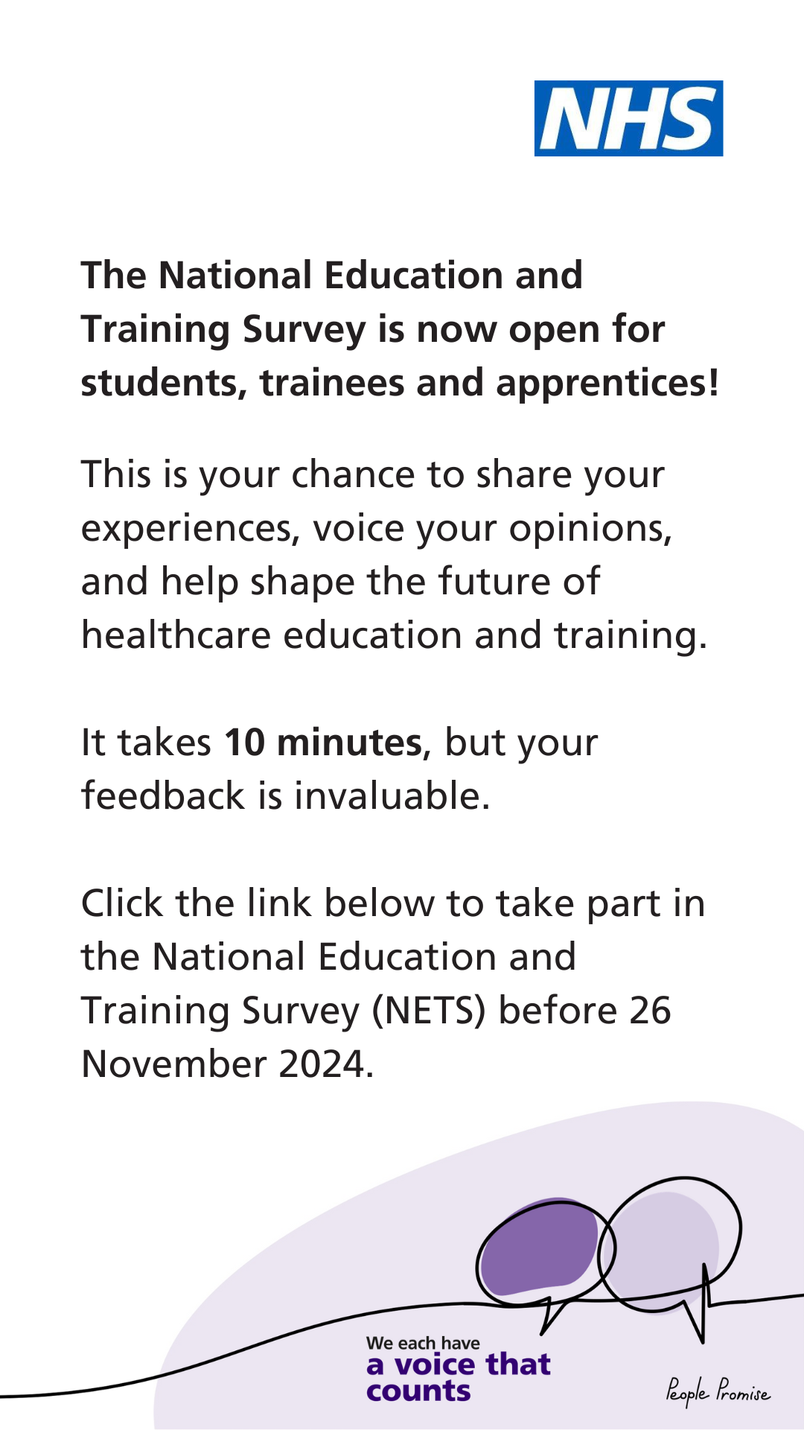
Social media assets
All assets are available on the NHS England Education Quality Portal
The following social media assets are available:
Facebook Post
Facebook Story
Instagram Post
Instagram Story
LinkedIn Post
X Post
* Examples of assets to communicate the messages have been drafted. Once signed off, assets will be created with correct social media logo, handle, ALT text and sizing for the platform they will be shared on.

Slide 20
Posters
These posters can be printed locally and placed in areas learners and trainees will be e.g., medical education centres, lecturer theatres, common rooms. All assets are available on the NHS England Education Quality Portal

Slide 21
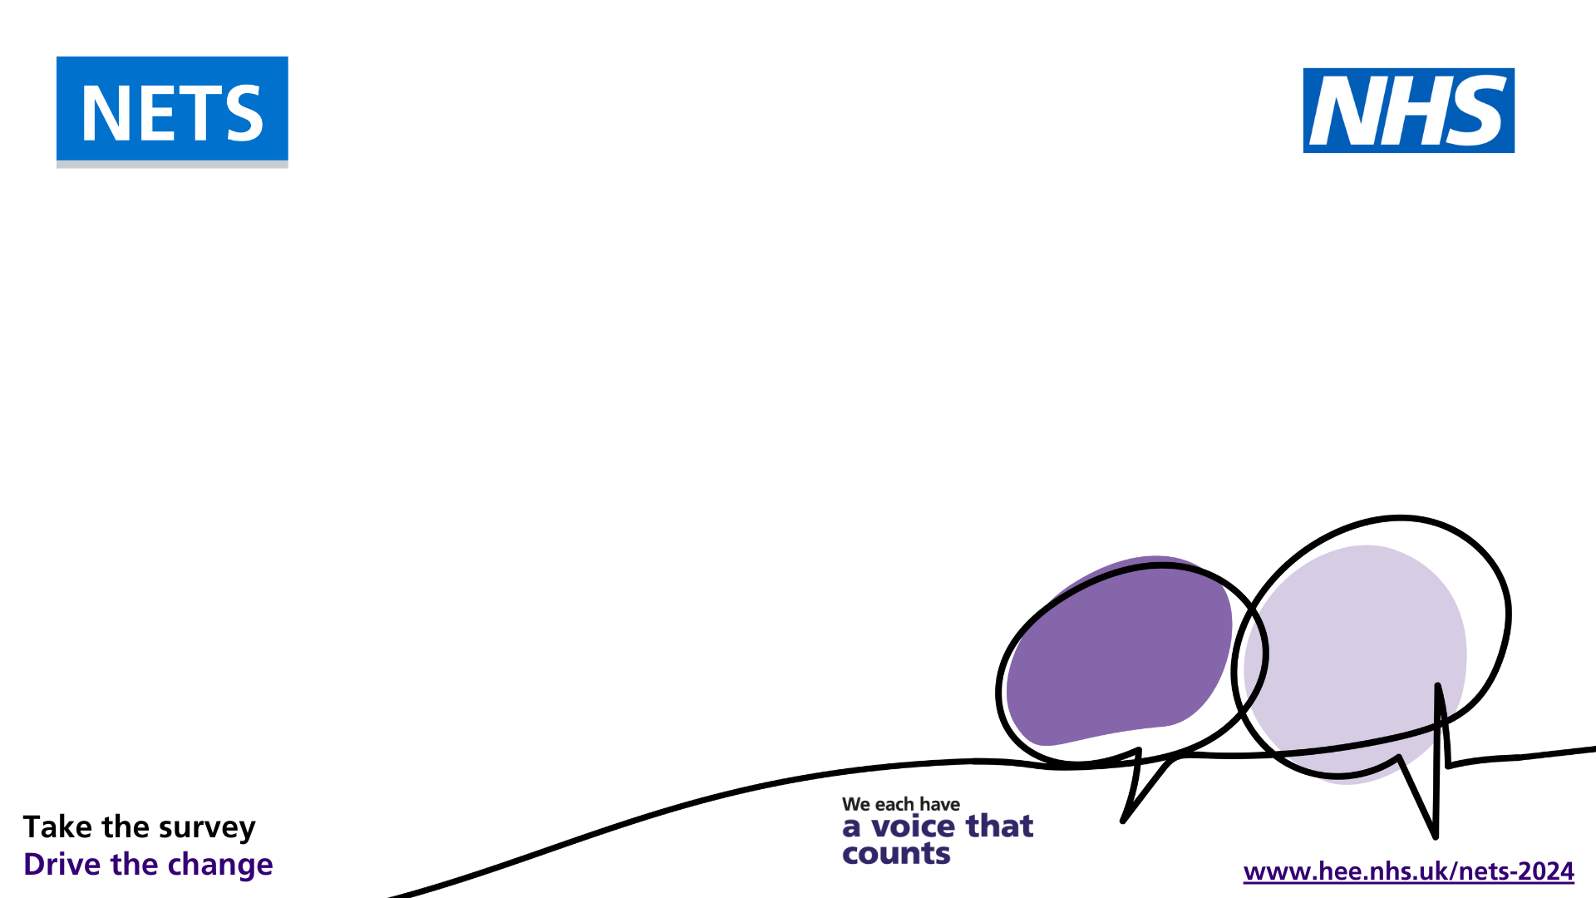
PowerPoint Presentations
All assets are available on the NHS England Education Quality Portal

Slide 22
Other assets
All assets are available on the NHS England Education Quality Portal
MS Teams Background
Email Signature

Slide 23
Contact us
Email: england.nets@nhs.net
Website: https://www.hee.nhs.uk/nets-2024

