Slide 1
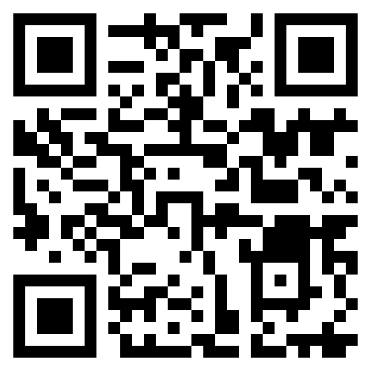
Do you wish you could make the NHS more equitable?
Do you care about the environment and practicing more sustainably?
Maybe you want to learn more about patient centred care?
Then why don’t you try:
Enhance is a self-guided programme to help improve your generalist skills. It is open to anyone who works for the NHS, but it is particularly aimed at FY1s and FY2s. Find out more at www.kss.hee.nhs.uk/enhance
Notes:
First three points highlight generic offers for all foundation doctors nationally
- improving and preparing for future practice
- aid with sign-off of curriculum
- if complete all 6 workbooks of either enable or explore – receive a leadership certificate which is equitable to a 3-day leadership course
Whilst the bottom three points highlight some of our regional-specific content
- content – particularly for the domains covered later in the programme. Access to specialist teaching/online content that allows them to complete their enhance work. Particularly on sustainability and population health
- we will be offering opportunities to present their enhance content at regional meetings in – important CV-building points and for speciality applications and awarding prizes for exceptional content for both enable and explore- again brilliant opportunity for future applications.
- both schools will have unique explore rotations – touch on later.

