Slide 1
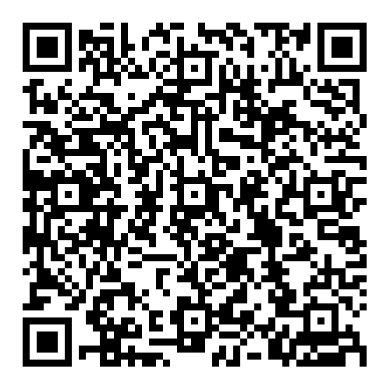
Enhance Enable
Enhance enable is a programme to help you improve your non-clinical generalist skills. It covers topics such as complex multimorbidity, social justice and health equity, environmental sustainability and population health.
Enhance enable is entirely optional and self-directed. This means you can pick areas that interest you and guide your own learning. The work you do will help you with foundation sign off.
If you are interested follow this QR code for more information:

Slide 2
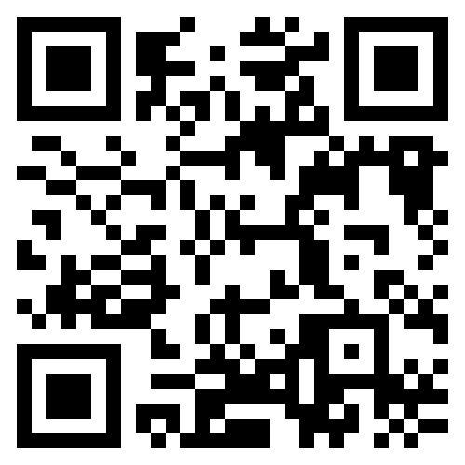
Enhance Enable
This teaching session is relevant to the following enhance enable domains (DELETE AS APPROPRIATE):
Person centred practice
Complex multimorbidity
Population health
Environmental sustainability
Systems working
Social justice and health equity
Contextual leadership
This is relevant because (INCLUDE SHORT EXPLANATION HERE):
We have a KSS website for the enhance enable programme. Follow this QR code to learn more:

